Slide 1

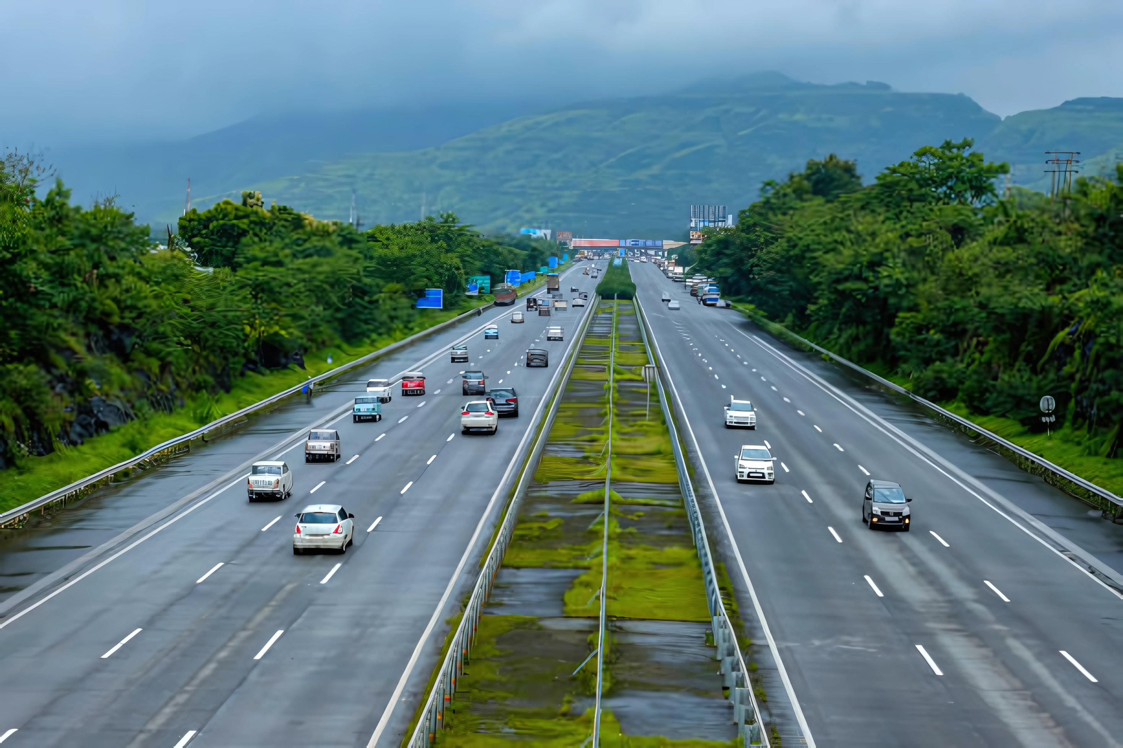
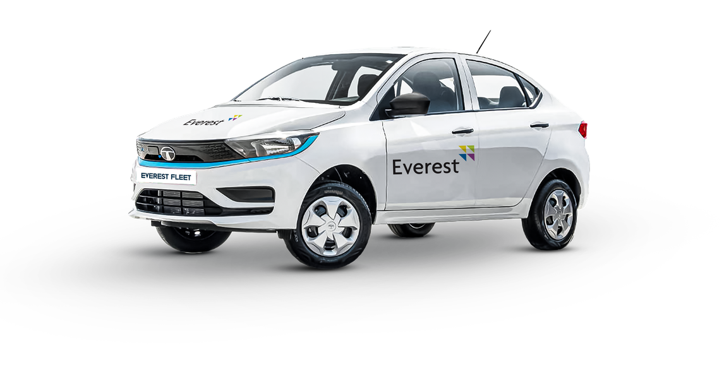
ENVIRONMENTAL, SOCIAL AND GOVERNANCE REPORT
2024-25

Slide 2




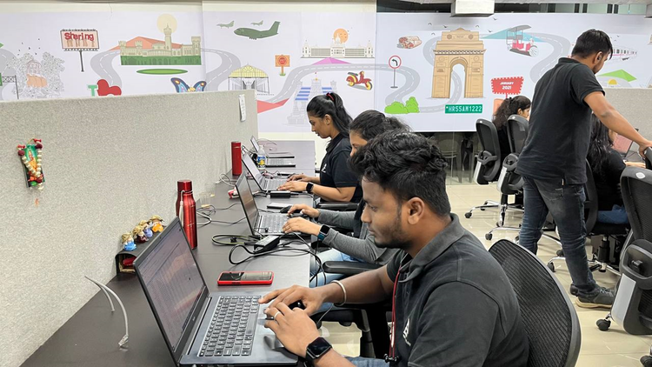


INTRODUCTION
INTRODUCTION
Message from Our CEO
About Everest Fleet
Everest’s Journey Map
Our Purpose
Our Vision
LEADERSHIP & LEGACY
Our Founder & Co-Founders
OUR ESG COMMITMENT
Sustainability Blueprint
Environmental Stewardship
Our ESG Command Centre
PEOPLE & PARTNERSHIPS
Stakeholders at the Heart of Our Journey
Employees
Drivers
Clients & Investors
DISCLOSURES & STANDARDS
APPENDICES
Contact Us
GRI Index

Slide 3
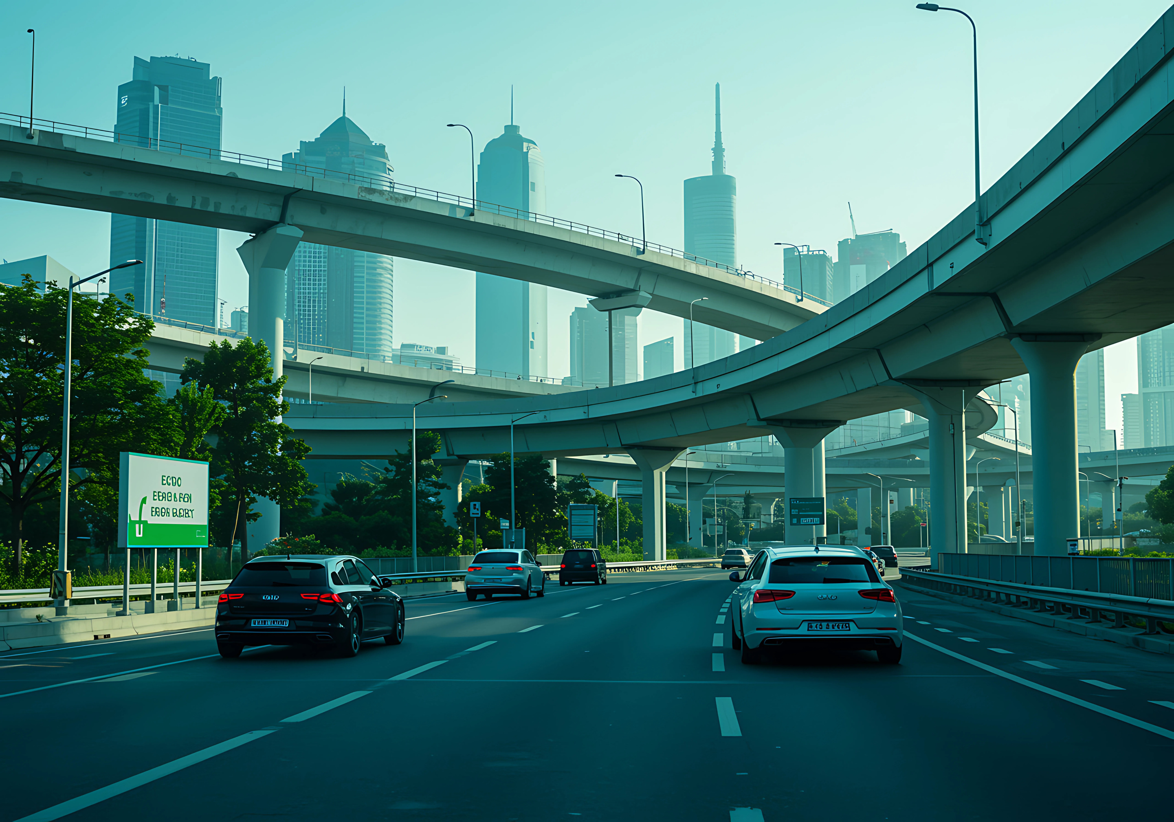
INTRODUCTION

Slide 4
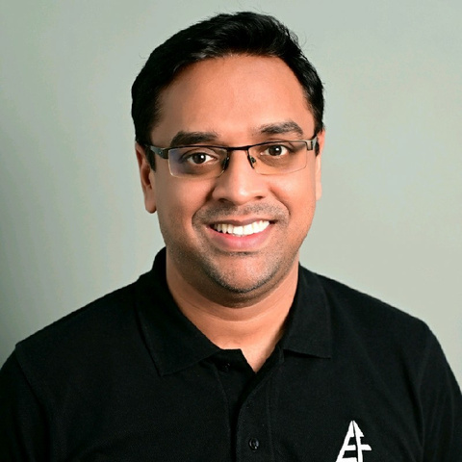
A MESSAGE FROM OUR CEO
At Everest Fleet, our journey began with a simple mission — to transform shared mobility in India and empower those who drive it. Over the years, that mission has grown into a movement. Today, with over 18,500+ cars across seven cities and a strong focus on electric and CNG vehicles, we are proud to be at the forefront of sustainable, inclusive, and tech-driven mobility solutions.
DRIVING MOBILITY WITH PURPOSE
Our work goes far beyond fleet management. At the heart of Everest Fleet is a belief that mobility can be a force for good — creating income opportunities, reducing environmental impact, and powering cities forward. As we continue expanding across geographies, we focus on providing cleaner vehicles, safer rides, and a better quality of life for our driver partners and customers.
In 2025, we deepened our commitment to sustainability by accelerating the adoption of EVs in our fleet and building infrastructure to support a greener future. Our goal is not just to adapt to the future of mobility but to shape it.
EMPOWERING OUR DRIVERS
Every Everest Fleet vehicle is more than just a car — it’s a livelihood. We’ve taken bold steps to enhance financial inclusion through initiatives like our Drive to Own program, which allows driver-partners to move from renting to ownership. We also continue to invest in simple, tech-enabled onboarding and training processes, ensuring every partner is equipped to succeed.
We understand the everyday challenges of our driver community, many of whom come from modest backgrounds. That’s why we focus on long-term, meaningful support — whether it’s through flexible earning models, safety initiatives, or dedicated driver support teams on the ground.
BUILDING WITH INTEGRITY AND INNOVATION
As we scale, we stay grounded in our values — transparency, integrity, and innovation. We’re building not just a company but a platform that enables real, measurable impact. In the coming year, we’re doubling down on tech-driven operations, better data insights, and customer experience excellence.
We also recognize the importance of governance and accountability. Our teams are actively working on ESG-aligned frameworks that help us grow responsibly while contributing to India’s climate goals and inclusive economic development.
LOOKING AHEAD
2025 and beyond hold immense promise — not just for Everest Fleet, but for the future of urban mobility in India. We’re excited to continue working hand-in-hand with driver-partners, city governments, and platform partners to build a more efficient, eco-friendly, and equitable mobility ecosystem.
Thank you to our incredible team, our partners, and our drivers — you are the reason we keep moving forward.
Siddharth Ladsariya
Founder & CEO
Everest Fleet

Slide 5
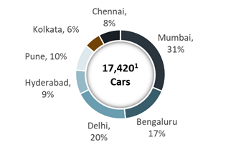
ABOUT EVEREST FLEET
BUSINESS OPERATION HIGHLIGHTS
Navigating distance with 20,000+ Vehicles
Founded in 2016, Everest Fleet is an end-to-end fleet manager for ride hailing platforms such as Uber and Ola
Key Offerings:
Provides standardized well-maintained fleet of cars to ride hailing platforms
Manages both cars and drivers with maximum efficiency
Operations in 7 cities in India: Mumbai (HQ), Delhi, Bengaluru, Hyderabad, Pune, Kolkata and Chennai
Founded by Siddharth Ladsariya and Prihaans Dedhiya
18000+
CNG Cars
2000+
EV Cars
180+
Goods Carrier
7
Key cities in India
SUSTAINABILITY HIGHLIGHTS
OUR REGIONAL DISTRIBUTION
100 %
CNG + EV FLEET
1850+ EMPLOYEES
8
CO-FOUNDING MEMBERS
20,000+
DRIVER
POOL??
250+ EVEREST INTRA
PRENEURS
122,605 partners have taken vehicles
8 PROJECT LEADS

Slide 6
EVEREST’S JOURNEY MAP
JUN 18
NOV 19
JAN 22
MAY 22
MAY 23
JUL 23
OCT 16
Raised $6M from Param Capital, InCred capital, Artha Ventures and Family offices
Raised $20M from Uber and other key family offices and HNIs
Launched Intercity Business
DEC 24
Pivoted to funding car purchase via off balance sheet model
Raised $1.4 Mn via from consortium of individuals along with Artha Venture Fund
Launched B2B (ETS) business
Started with the operations in Mumbai
Awarded best fleet partner by Uber for the 2nd consecutive year
Oct 16
Oct 16
Oct 16
Oct 16
Oct 16
Raised US $1 Mn in a funding round led by Artha Venture Fund and Rockstud capital
Everest Fleet driver app was created.
Partnered with Uber India to launch Uber Green
Onboarded first DFI as a lender - GuarantCo
Launch MITR: Business
Launched refrigerated Vans Business
Fleet grew to 20,000+ cars
Launched
EV Pilot
APR 17
SEP 19
NOV 20
FEB 22
AUG 22
JUN 23
DEC 23
FEB 25

Slide 7

OUR PURPOSE
To harness our expertise in transporting people and goods, driving positive impact across lives of our drivers, partners and employees.
VALUES
E
V
E
R
E
S
T
ENTREPRENEURIAL
Being passionate about what we do, taking accountability for all actions and results. Boldly pushing the limits on what's possible, showing initiative to create a difference.
VIGILANT
Ever-focused on being attentive to the safety of our driver partners, their end-customers and our clients. Mobility must be safe for all
travelers.
EMPOWERING
With a culture of inclusion, mutual trust and mutual respect, we enable all our drivers, internal teams and clients to do better and do more.
RIGOUROUS
Striving for excellence with rigor, always look for ways to be more productive, efficient, innovative and sustainable, positioning the company for success.
EMPATHETIC
Fostering a culture of empathy, to ensure we are always solving for what's vital. Always focused on the needs of our customers, teams, communities and environment.
SHARING
Co-creating and collaborating, we work with our teams to solve real problems, driving our collective energy towards the greater good.
TRUST
Being ethical, honest, and ensuring transparency in everything we do. Creating an environment where people feel safe, respected, and confident in our ability to meet their needs

Slide 8

OUR VISION
OUR STRATEGIC OBJECTIVES
We will pursue continuous improvement in our registry system, win more registry clients, both listed and unlisted, and expand the range of CSDR services offered.
We will clarify our legal position and update CSD rules with CMSA and stakeholders.
We will review Tanzanian CSD with custodian banks against frontier markets and collaborate with DSE for new business lines.
We will establish capacity-building
partnerships with other CSDs and revise our fee structure.
Additionally, we will supplement ISIN with LEI business and aim to increase revenues to 30% of DSE group income over five years. Strengthening CSDR capabilities and enhancing IT services for cybersecurity are also key priorities

Slide 9




OUR VISION
INITIATIVES
We are currently implementing initiatives to enhance the comfort and effectiveness of interactions while driving, such as having Women Driver Relationship Managers.
INITIATE
We also collaborate with NGOs like Action Aid, Bangalore, providing our cabs for training batches of women drivers who are assured placements with Everest Fleet upon course completion.
COLLABORATE
ENGAGE
Furthermore, we actively engage with various NGOs and job portals to attract women drivers to join Everest Fleet.
We have streamlined performance benchmarks during the nesting period to facilitate women's integration into our business seamlessly.
STREAMLINE

Slide 10

LEADERSHIP AND LEGACY

Slide 11
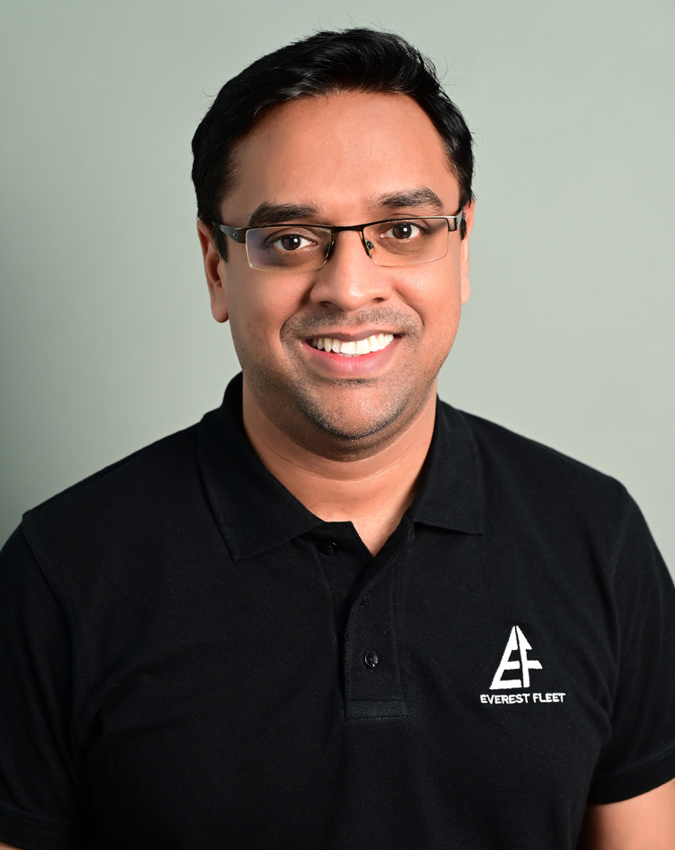



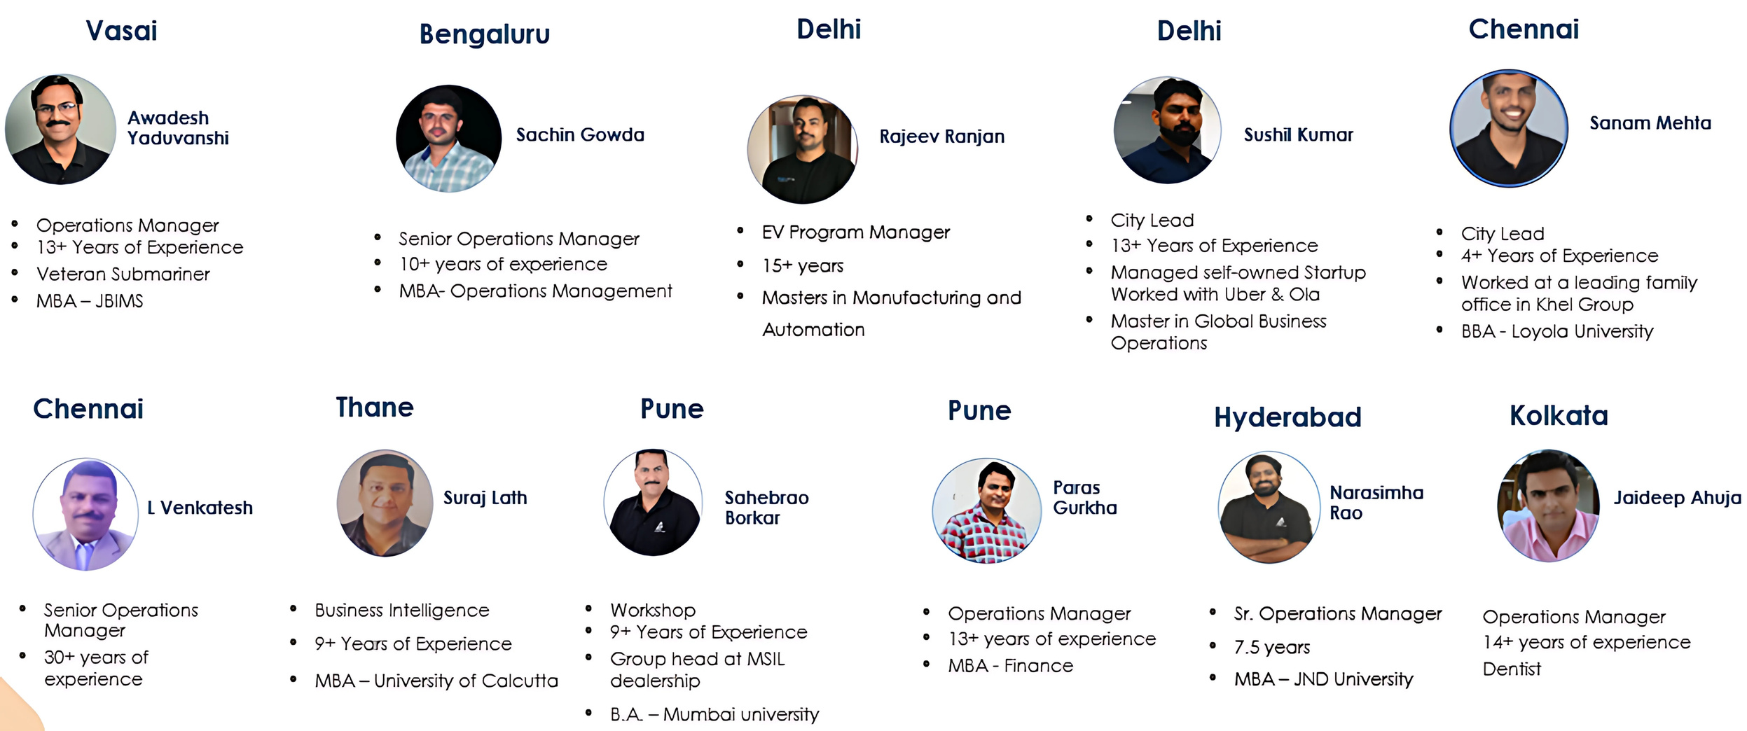


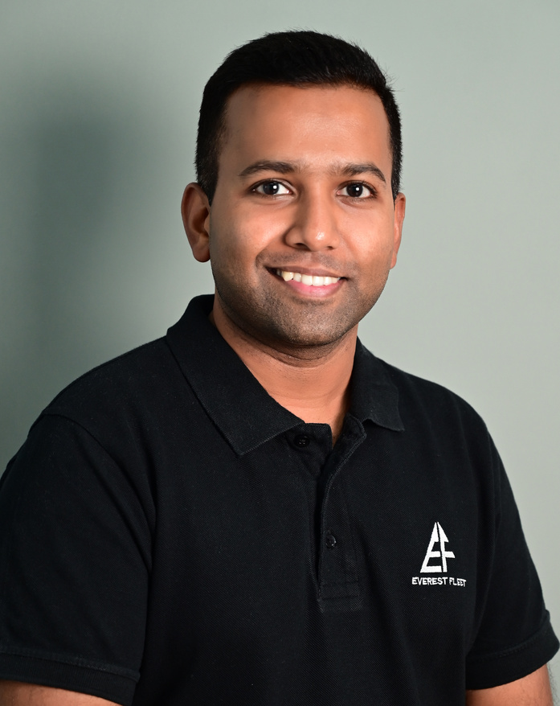

OUR FLEET
CO FOUNDING TEAM
REGIONAL / PROJECT LEADS
Siddharth Ladsariya
Anand Chheda
Prihaans Dedhiya
Himani Ladsariya
Active Angel Investor with 160+ investments
Early Investor in India's first unicorns such as OLA, OYO, Myntra, FarEye
Computer Engineer & MBA- University of Rochester
17+ Years of Experience
Marketing - American Express, HUL and Lodha
MBA-MICA
8+ Years of Experience
Worked at Ascent-A PharmEasy Company
MBA - Chetna College
15+ Years of Experience
Ran a tech startup
Tech Lead with Lehman Brothers
Computer Engineer & MBA- University of Rochester
Apurav Mahajan
Shivang Unadkat
Amar Kerkar
Monil Sheth
15+ Years of Experience
Worked at a leading family office in Bahrain
Computer Engineer & MBA -University of Rochester
8+ Years of Experience
Investment Banker-III Capital
Bachelors of Financial Markets
CFA Level 3 Candidate
17+ Years of Experience
Business Head at Repro Books
BMS, Marketing-University of Mumbai
10+ Years of Experience
Worked with Axis Bank & ICICI Bank
MBA-JBIMS
Chartered Financial Analyst (US)

Slide 12
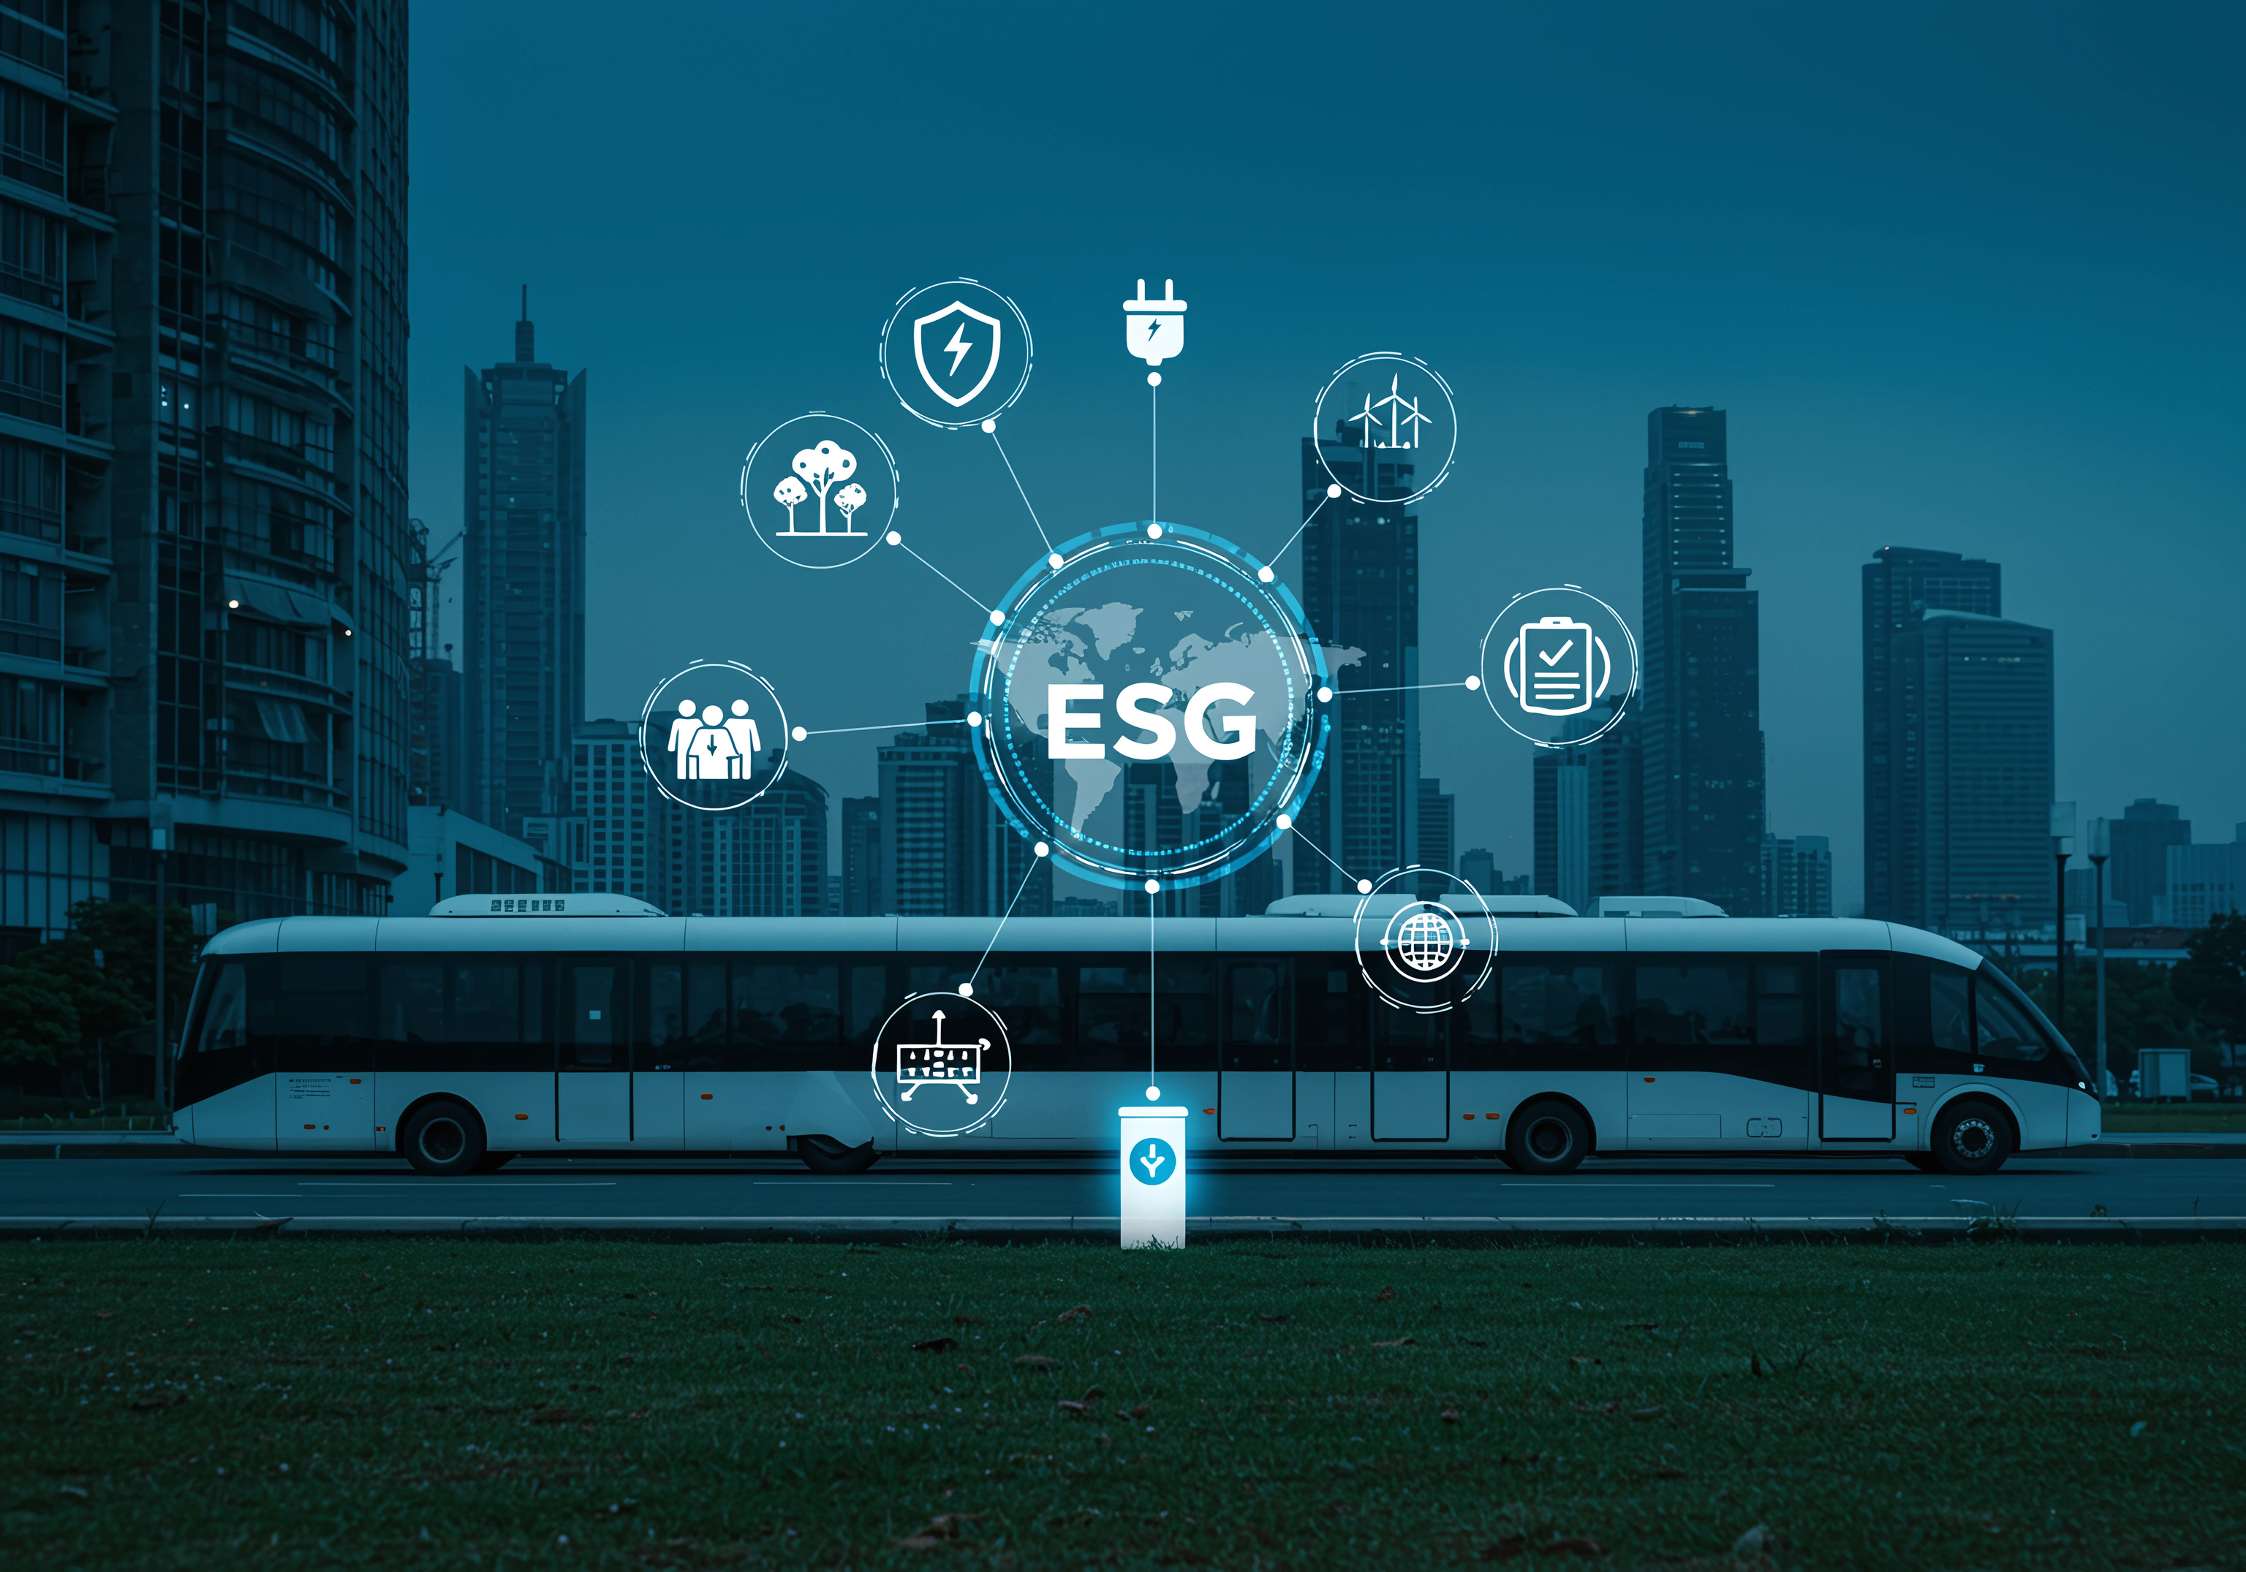
OUR ESG COMMITMENT

Slide 13
OUR SUSTAINABILITY BLUEPRINT
Our purpose is to harness our expertise in transporting people and goods, powering change in how they move, driving positive impact across lives of our drivers, partners and employees
PURPOSE
SUSTAINABILITY STRATEGY
Fueled by sustainability, we pledge to empower drivers, advocate environmental consciousness, and enforce strong governance.
STRATEGIC PILLARS
Environmental Sustainability
Sustainable Governance
Strategic Partnerships
Advancing eco-consciousness by transitioning to electric vehicles, curbing carbon emissions.
Conducting our business with integrity, transparency, and ethical behaviour.
Co-creating and collaborating to solve real problems, driving our collective energy towards the greater good.
GOALS
Decarbonization of Fleet
Operational
eco-efficiency
Effective & Ethical
Governance
Robust
Institutions
External Stakeholder Relationship
Driver & Employee
Wellbeing
FOCUS AREAS
Advocating for sustainable mobility proudly steering an eco-friendly CNG and EV fleet.
Driving eco-efficiency through waste, water, and data management—reinforcing our commitment to sustainability.
Ensuring transparent, fair, and accountable decisions that uphold integrity and prioritize all stakeholders.
Building strong ESG frameworks to drive sustainability, manage risks, and create long-term stakeholder value.
Building strong ESG frameworks to drive sustainability, manage risks, and create long-term stakeholder value.
Empowering employees and nurturing excellence.
Uplifting drivers through jobs and entrepreneurship.
OBJECTIVES
EHS Policy, Responsible Procurement Policy, Supplier Code of Conduct
Code of Ethical Business Conduct, Whistleblower Policy, Data Privacy & Security Policy,ESG Policy ESG Steering Committee Charter
SCoC, Responsible Procurement, DEI Policy, Human rights Code of Ethical Business Conduct, Grievance Redressal Policy (Employees, third-party, and drivers)
POLICIES
Minimization of carbon footprint through use of CNG fleet rather than fossil fuel powered vehicles
In the process of transitioning to a completely electric fleet
Establishment of systems and processes to monitor resource consumption (energy, water, waste) of operations in order to optimize resource utilization.
Formalization of policies and systems to uphold highest ethical standards, going beyond compliance and towards ESG leadership
Establishment of a robust ESG governance and policy structure to effectively drive ESG throughout the organization
Health & Safety Initiatives -for Drivers & Employees
Well-being initiatives - for Drivers & Employees
Corporate Social Responsibility Initiatives
Investor and Customer Relationships
PRACTICES

Slide 14
CREATING ENVIRONMENTALLY SUSTAINABLE PRACTICE
Everest Fleet is more than a ride; it’s a commitment to a greener, more efficient, and connected tomorrow.
Journey to green, low emission fleet
As the largest fleet management company in the country, we are leading by example. We have made a conscious effort to not invest in fossil fuel-powered vehicles. Our 16,500-vehicle strong fleet consists of 15,000 CNG vehicles and 1,500 electric vehicles.
Formalization of Environmental Policies
We have redeveloped and standardised our Environment, Safety and Health policy as leading industry with the goal of minimising environmental risks associated with our operations.
We have also formalised a Sustainable Procurement Policy, to inculcate sustainable practices among our Suppliers and business partners
Environmental
Performance Data
In order to track key KPIs related our environmental footprint, we have developed an Environmental Data Management Tool. This tool allows us to capture data on environmental parameters like energy, water, waste, etc and monitor trends/set targets to improve our performance.
We believe that environmental sustainability goes beyond our operations and are committed to align our suppliers and business partners with our sustainability strategy. In this light, we have included key environmental clauses in our Supplier Code of Conduct and have also initiated a ESG-based Supplier Assessment program on a pilot basis.
Responsible Procurement
Intended Outcome: Through the adoption of sustainable practices, we at Everest strive to foster environmental stewardship in our operations as well as in our value chain, ensuring a greener future for generations to come.

Slide 15

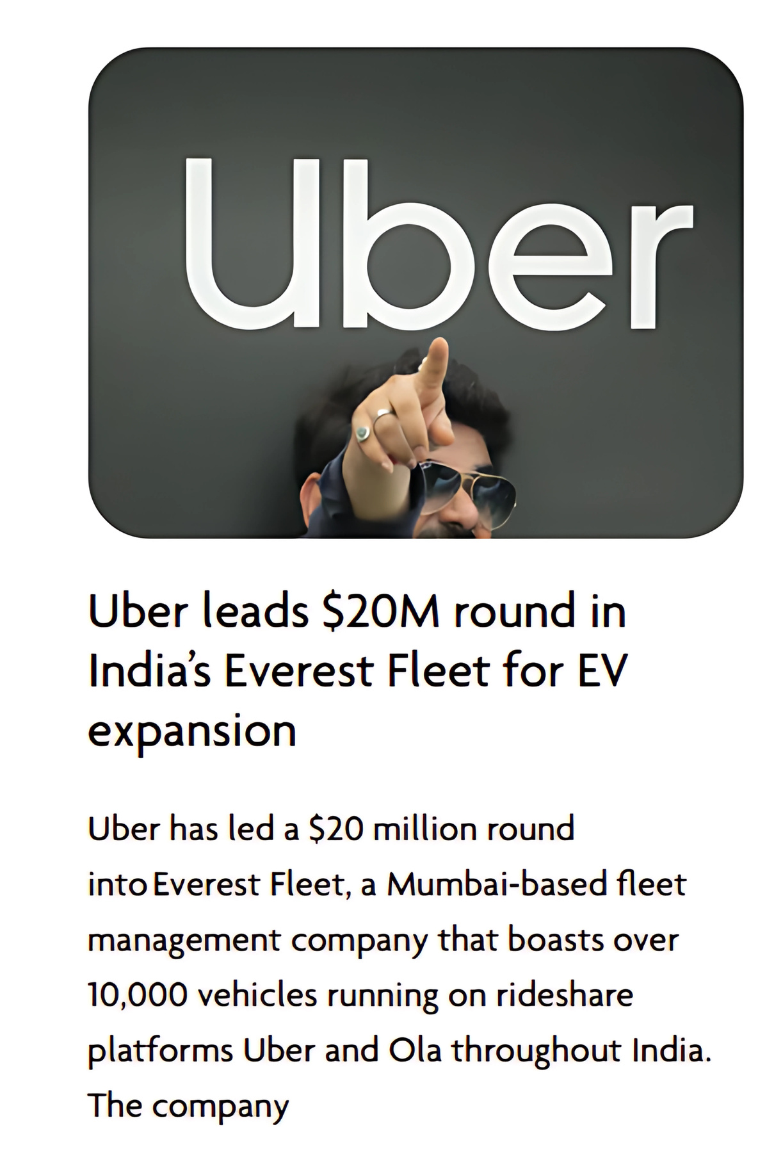
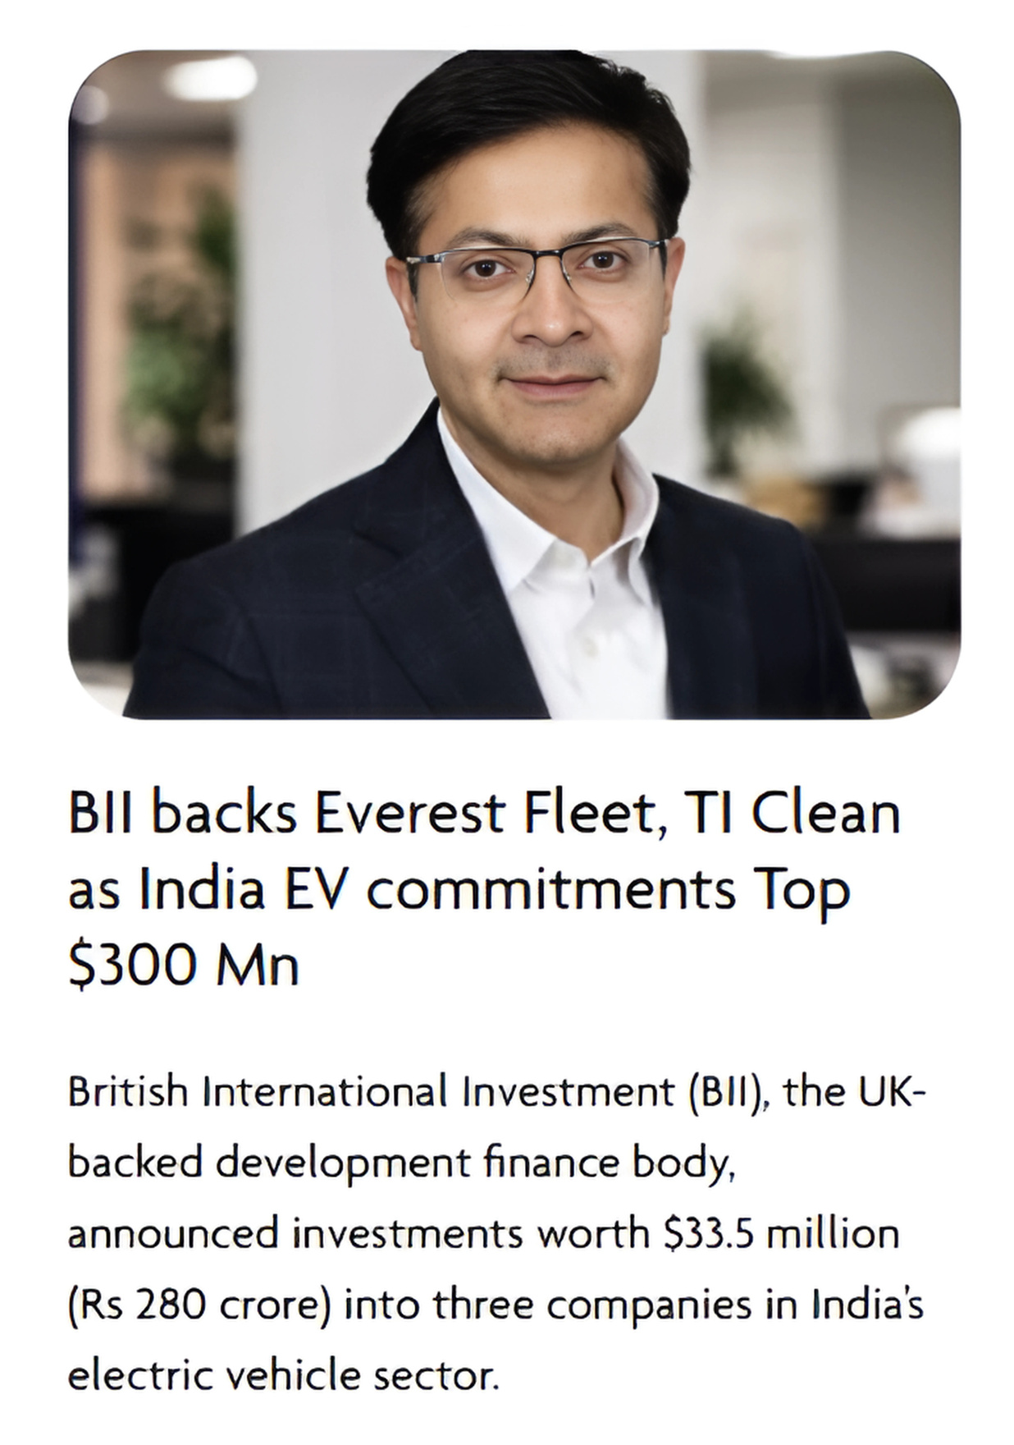
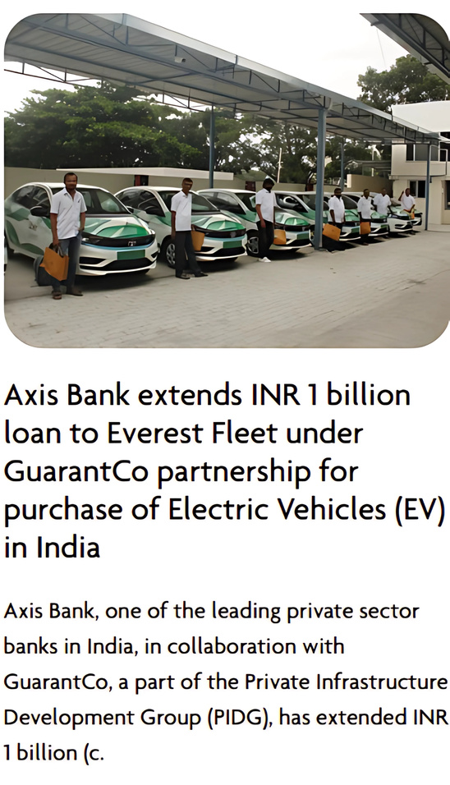
JOURNEY TO GREEN, LOW EMISSION FLEET (1/2)
DRIVERS OF EV TRANSITION
OUR PRIORITY
Government Incentives: India's FAME scheme promotes EV adoption through subsidies, road tax and registration fee exemptions, and preferential electricity rates for charging.
Carbon Emission Reduction: Everest Fleet's exclusive use of CNG and electric vehicles has significantly reduced emissions across its 20,000+ vehicle fleet.
HOW ARE WE GOING TO DO IT
Lower Operating Costs: EVs incur lower running expenses due to stable electricity prices and reduced maintenance needs, owing to fewer moving parts.
Moving towards
100%
Fleet
Total emissions in FY 2024-25
WHERE WE ARE TODAY
Market Demand & Consumer Preference: Rising environmental awareness in India is boosting demand for EVs. Fleet companies offering electric options can attract eco-conscious customers and gain a market advantage.
Number of vehicles (CNG+ Electric)
18000+
2000+

Slide 16
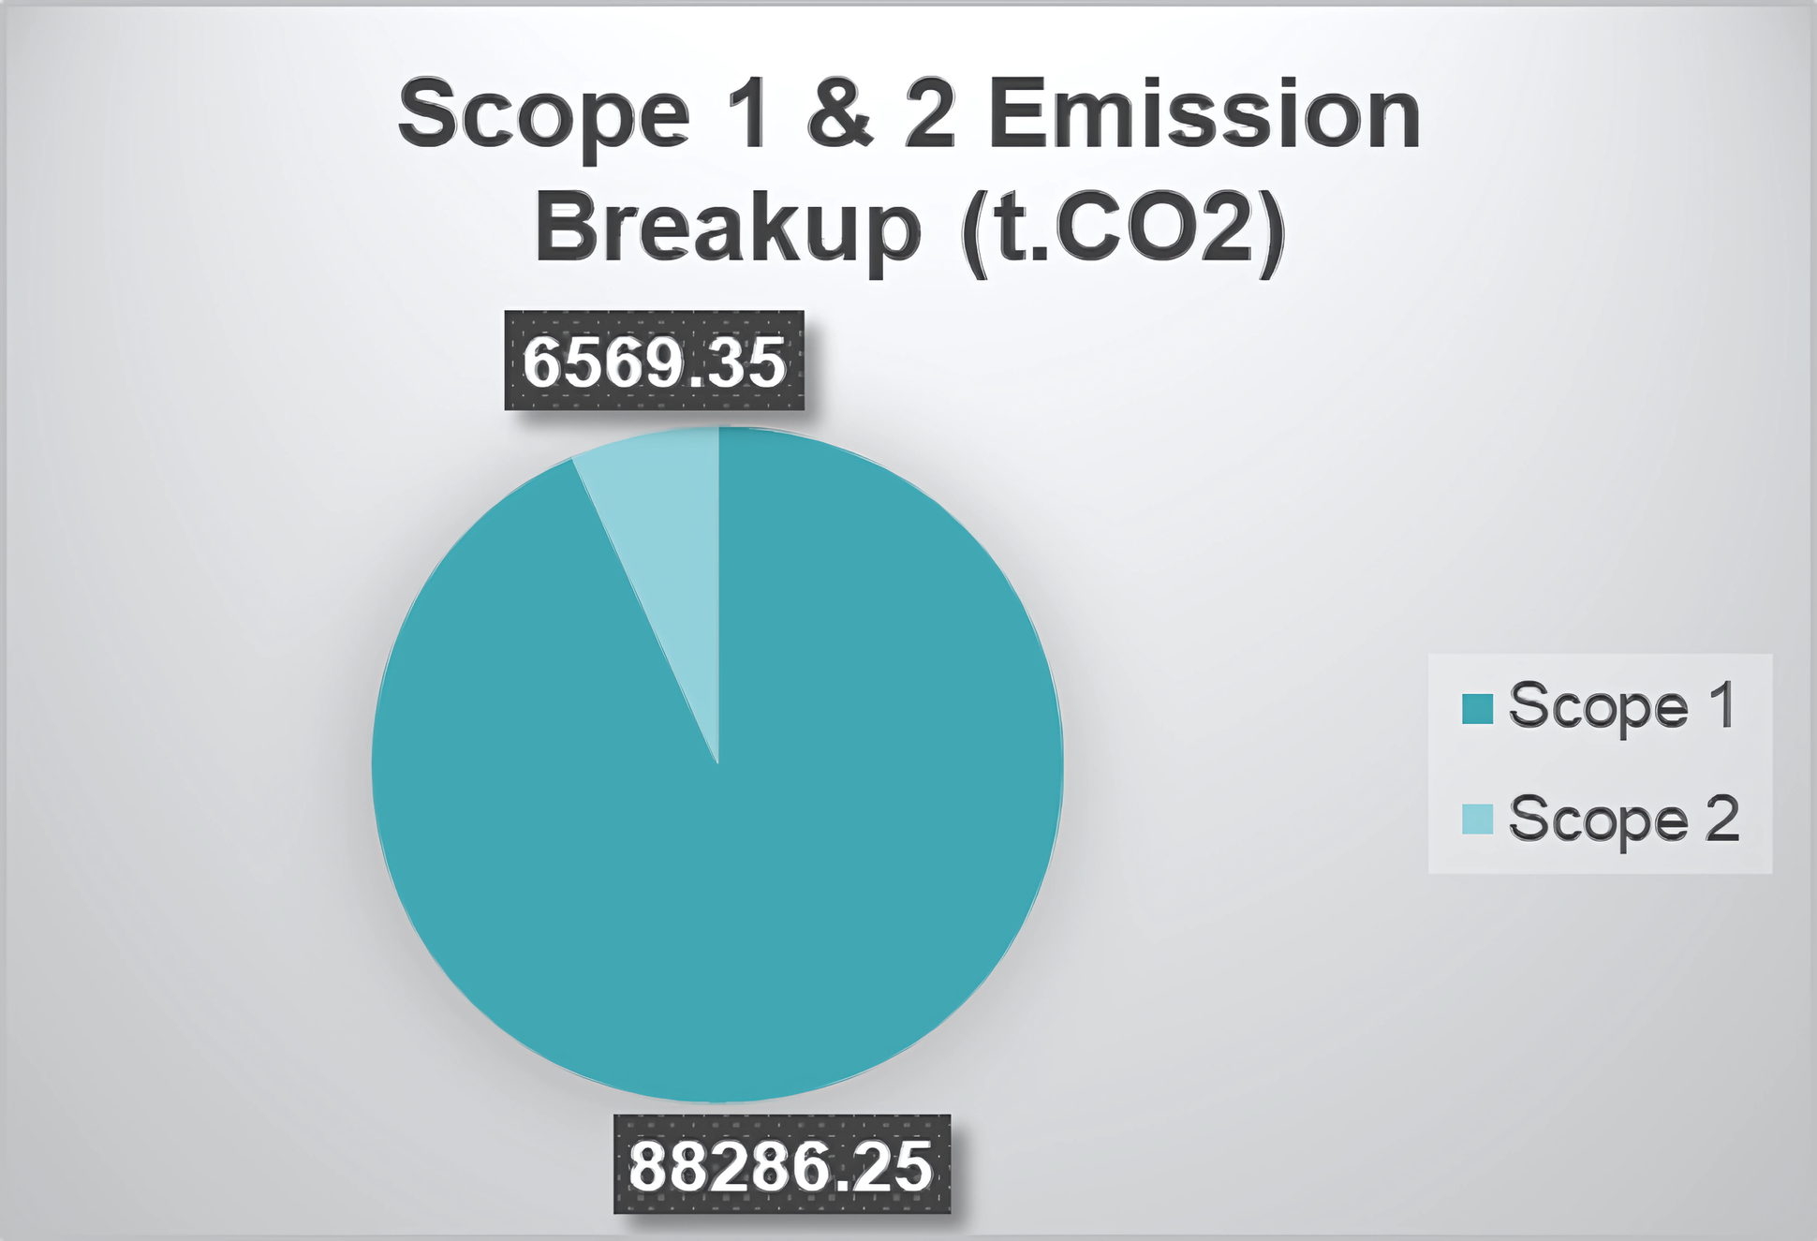
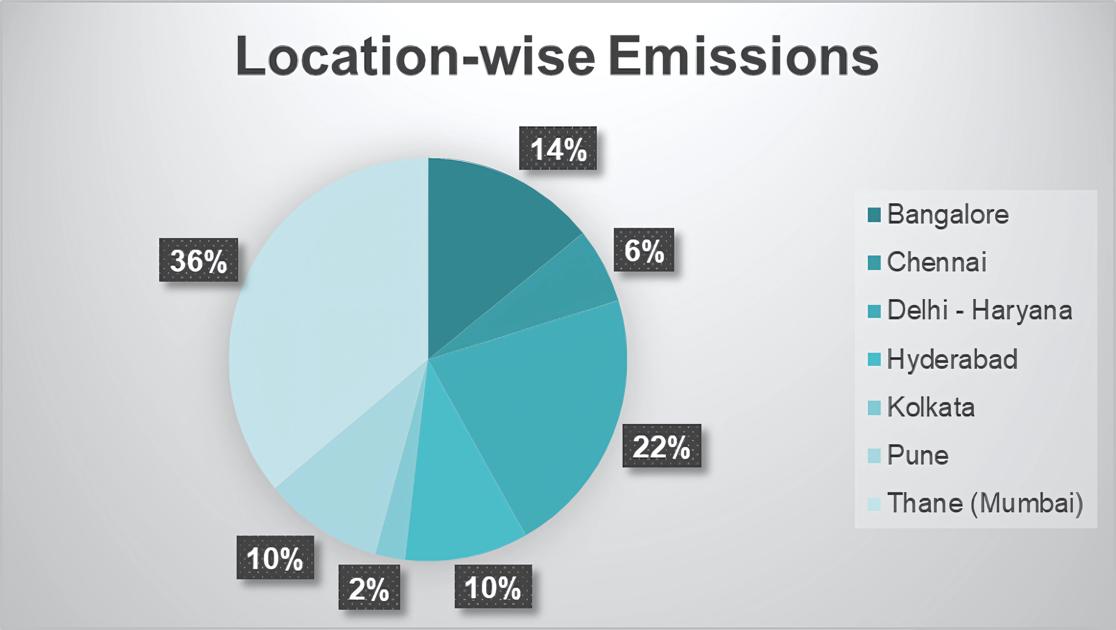
JOURNEY TO GREEN, LOW EMISSION FLEET (2/2)
Everest Fleet conducted an assessment of its Scope 1 and 2 emissions based on energy and electricity usage across the 7 cities where it operates. We believe measuring and disclosing emissions is the first step in building a strong decarbonization strategy. This assessment revealed trends in emissions by type, location, and time period.
Scope 1 emissions (emissions from owned/controlled sources) were found to constitute 93% of the company's emissions, while Scope 2 emissions (emissions from purchases electricity) were found to constitute 7% of the total emissions
The above table provides a breakup of emissions (Scope 1 + 2) across Everest's 7 cities of operation. Mumbai and Delhi-Haryana were found to be city responsible for the most emissions

Slide 17


ENVIRONMENTAL POLICY DEVELOPMENT
CODIFYING OUR ENVIRONMENTAL VISION
Codifying environmental commitments, practices, and programs into a policy provides a clear framework for integrating sustainability into the company's operations, guiding decision-making, and demonstrating accountability to stakeholders. It also helps to establish a culture of environmental responsibility, ensuring consistent implementation of best practices and facilitating continuous improvement towards achieving environmental goals.
Sustainable Procurement Policy
1. Purpose and Objectives
At Everest Fleet Management Company, we are committed to conducting our business in a socially responsible and environmentally sustainable manner. Our Sustainable Sourcing and Procurement Policy outlines our commitment to sourcing products and services responsibly, reducing environmental impact, and supporting ethical labor practices throughout the supply chain.
The objectives of our Sustainable Sourcing and Procurement Policy are as follows:
Minimize environmental impact across the value chain by reducing footprint, waste production, and resource consumption.
Promote ethical standards within the global marketplace and in all aspects of sourcing from supplier selection to final product delivery.
Ensure product quality and safety. We will purchase goods and services of high quality, safe and responsibly sourced aligning with product specifications.
Engage with suppliers dedicated to ethical and sustainable development. We seek to work with suppliers who comply with human rights, environmental legislation, labor laws, and ensure their self-transparency and continuous improvement.
2. Scope
This policy applies to all procurement activities conducted by Everest Fleet Management Company, including but not limited to:
Sourcing of goods and services
Evaluation and selection of suppliers across aspects of sourcing
Contract negotiations and vendor relationships
Applies to all operations conducted by Everest Fleet, including vehicle management, maintenance, and service centers (garages), and all personnel associated with our operations. It encompasses the entire fleet lifecycle, from procurement to decommissioning.
3. Sustainable Sourcing Principles
Our Sustainability Impact in this process applies to: who demonstrates environmental responsibility in their operations, uses sustainable materials and energy resources.
Key principles to be followed include but are not limited to:
Supplier’s commitment to ethical business practices
Compliance with all relevant legal and regulatory requirements
Sourcing with environmental regulations and obtaining relevant certifications (e.g., ISO 14001)
This policy outlines Everest’s commitment to sourcing products and services responsibly, minimizing environmental impact, and supporting ethical practices throughout the company’s supply chain
This policy applies to all procurement activities conducted by Everest Fleet Management Company, including but not limited to: Purchase of vehicles, equipment, and materials, Contracting of services such as maintenance, repairs, and consulting
Everest commits to regularly monitor and evaluate the performance of its suppliers in relation to sustainability and ethical standards. This may include conducting audits, collecting data on environmental impact, and reviewing compliance with contractual obligations.
The policy goes beyond legal compliance and makes several environmental commitments concerning Environmental objectives and KPIs - in the areas of resource consumption, emissions, waste management and pollution management.
ENVIRONMENT, HEALTH AND SAFETY POLICY
The policy also highlights the company’s commitment to uphold the highest safety standards for its employees. This will be achieved through hazard identification, risk assessments and emergency preparedness response plans
Policy is aligned with ISO 14001, which demonstrates a commitment to proactively managing environmental impacts, ensuring compliance with relevant regulations

Slide 18









Environmental Performance Data
Everest Fleet recognizes that a crucial aspect of estimating and managing its environmental impact is to quantitatively measure and benchmark its environmental performance. Tracking environmental performance also helps to comply with regulations, enables informed decision-making and supports the company's long-term sustainability goals.
AMONGST OTHERS
DEVELOPMENT OF DATA MANAGEMENT TOOL
Structured data templates for seamless data collection and consolidation, maintaining a single source of auditable data on key KPIs
ENERGY CONSUMPTION
BUSINESS PROBLEM
Disaggregated data being collected across cities of operations
•Manual collection of city-wise data with minimum consolidation/analysis
Little to no alignment with requirements of reputed sustainability frameworks/standards
No quantified goals/targets to guide Everest's sustainability strategy
T
WASTE MANAGEMENT
Real-time editing and decision-useful dashboards to monitor trends, set targets and communicate progress
EVEREST DATA MANAGEMENT TOOL
SOLUTION
WATER CONSUMPTION
The conversion factors and calculation methodologies of the tool are referenced to leading industry standards and protocols
GHG EMISSIONS

Slide 19
PROMOTING SUPPLY CHAIN SUSTAINABILITY
Engaging our Value Chain Partners
As part of Everest's ambition to be a responsible steward of the environment in which it operates, one key strategy of the company is to engage with suppliers on environmental issues. Doing this fosters collaboration and transparency throughout the supply chain, allowing for the identification and implementation of sustainable practices. By working together, Everest can reduce environmental impact, mitigate risks not only of its own operations but those of its value chain as well.
Policy
SUSTAINABLE PROCUREMENT POLICY
SUPPLIER CODE OF CONDUCT
SUPPLIER ASSESSMENT AUDITS & INSPECTIONS
Self-Assessment
As part of our commitment to maintaining high standards and ethical business practices, we conduct annual self-assessments with our suppliers. These assessments empower our suppliers to evaluate their performance, identify areas for improvement, and align with our organizational values. Through self-assessment questionnaires, suppliers assess their adherence to quality standards, compliance with legal requirements, environmental sustainability, and labor practices. By engaging in this introspective process, suppliers contribute to a transparent and responsible supply chain. Regular self-assessments ensure that our partnerships remain robust, sustainable, and aligned with our shared goals.
1. Purpose and Objectives
At Everest Fleet Management Company, we are committed to conducting our business in a socially responsible and environmentally sustainable manner. Our Sustainable Sourcing and Procurement Policy outlines our commitment to sourcing products and services responsibly, minimizing environmental impact, and supporting ethical practices throughout our supply chain.
The objectives of our Sustainable Sourcing and Procurement Policy are as follows:
Establish and communicate integration with the broader risk strategy (logistics, waste reduction, emission reduction, transportation-related emissions, and sourcing risk).
Promote ethical standards within the supplier chain.
Ensure ethical considerations like optimal embedded carbon in all aspects of sourcing and procurement practices.
Focus on product quality and life-cycle approach, environmental safety, quality, safe handling, and reduced energy consumption within the product life-cycle.
Promote supplier relationships that are consistent with the organization’s code of ethics and demonstrate social responsibility, transparency, and continuous improvement.
2. Scope
This policy applies to all procurement activities conducted by Everest Fleet Management Company, including but not limited to:
Purchasing of goods and services.
Contracting with third-party vendors across various aspects of sourcing.
Distributors, logistics partners, and subcontractors.
3. Sustainable Sourcing Principles
The Sustainability Impact with this practice explains how downstream environmental responsibility is demonstrated via green procurement and energy management:
Suppliers are to adhere to the principles of pollution prevention with emphasis on environmental considerations.
Complying with environmental regulations and obtaining relevant certifications (e.g., ISO 14001).
Introduction
At Everest Fleet, we acknowledge that our suppliers — our supply partners — are the core of our ability to deliver world-class services to our clients and communities. Indeed, our growth over the years is due in large part to our commitment to this Code, our values — our commitment to working together in ensuring we meet our ethical expectations and commitments, national and local governance mandates. Thank you for the work you do and the added assurance you provide to Everest Fleet and our clients
Purpose and scope
We recognize the essential role our suppliers play in ensuring the day-to-day, safe, and responsible operation of our business. Our Supplier Code of Conduct serves as a guiding framework to foster ethical, responsible, and sustainable practices throughout our supply chain.
It includes the following requirements for suppliers:
Comply with all applicable laws, regulations, and industry standards in their operations.
Labor Rights: Suppliers are to uphold the principles established in the core labor standards of the International Labor Organization (ILO), such as the elimination of forced labor and child labor, and the right to freedom of association and collective bargaining.
Compensation and Working Hours: Suppliers are to provide fair wages and ensure safe and healthy working conditions, including reasonable working hours and rest breaks.
Environmental Responsibility: Suppliers are to reduce the environmental impact of their operations by minimizing waste, emissions, and resource consumption.
Anti-Corruption and Ethics: Suppliers must adhere to the highest standards of integrity, honesty, and transparency, and avoid conflicts of interest, bribery, or any form of corruption.
Monitoring and Compliance: Everest Fleet reserves the right to assess and audit the practices of suppliers to ensure compliance with this Code. Suppliers are encouraged to implement effective internal controls and monitoring mechanisms.
Monitoring and Reporting
We will regularly monitor and evaluate the performance of our suppliers in relation to sustainability and ethical standards. This may include conducting audits, collecting data on environmental impact, and reviewing compliance with contractual obligations.
Environmental Responsibility
We are committed to minimizing the environmental impact of our operations and expect our suppliers to share in this commitment. Our suppliers must comply with environmental regulations, minimize energy consumption, and adopt sustainable practices to reduce waste generation.
Everest's Supplier Code of Conduct and Sustainable Procurement Policy both emphasize on the importance of environmental responsibility for operations and within the value chain.

Slide 20

PROMOTING SUPPLY CHAIN SUSTAINABILITY
TURNING POLICY INTO ACTION
Serial No. | Theme | Question
1 | Compliance and Governance | Is the company fully compliant with all applicable environmental laws/regulations?
2 |  | Does the company have an environmental policy covering its commitment towards operational eco-efficiency (parameters such as air, water, energy, noise, emissions, biodiversity)?
3 |  | Does the company maintain a legal register for Environment-related compliance documents (EC, CTE, CTO, etc.) to help track the validity of the permissions and re-limits basis?
4 | Air Pollution | Does the company provide training to employees on environmental topics?
5 |  | Does the company have any systems in place to control air emissions (i.e. NOx, Sox, mercury, hazardous air pollutants) that are generated as a result of operations? (DG Sets)
6 |  | Does the company monitor and report air emission levels?
7 | Waste Management | How is waste handled by the company? What are the types of waste the facility generates and how are they disposed?
 |  | a) Hazardous waste authorization
 |  | b) Bio-medical waste authorization
 |  | c) E-waste authorization
8 |  | Does the company provide adequate safety equipment (gloves, masks, PPE) to employees for proper handling of waste?
9 |  | If Extended Producer Responsibility (EPR) is applicable to the entity’s activities, is the company’s waste channelization aligned to the Extended Producer Responsibility (EPR) plan submitted to the Pollution Control Board?
10 | Energy Usage | Does the company monitor and track energy consumption of offices and facilities?
 |  | Does the company have any programs/initiatives in place to reduce energy consumption/increase energy efficiency?
GUIDE FOR RESPONSIBLE SUPPLY CHAIN
Purpose of the framework
This framework is developed to screen the suppliers of Everest Fleet Private Limited. It will serve as a comprehensive tool to evaluate supplier maturity in Environmental, Social, and Governance (ESG) practices. By conducting these assessments, Everest aims to enhance transparency, promote sustainable business practices, and make informed decisions on engaging with suppliers, fostering a stronger commitment to ESG principles throughout its supply chain.
Objective
Enhance Sustainability: Identify areas for improvement in supplier sustainability efforts to align with our company’s sustainability goals, reduce environmental impact, and promote responsible business practices.
Mitigate Risks: Assess and mitigate potential ESG-related risks within our supply chain, ensuring business continuity and safeguarding our reputation.
Foster Collaboration: Establish a transparent and constructive dialogue with suppliers, encouraging them to embrace sustainable practices and develop a long-term commitment to responsible sourcing.
Drive Innovation: Encourage innovation and continuous improvement among suppliers, fostering the development of more sustainable and environmentally friendly products and processes.
Support Stakeholder Expectations: Meet the evolving expectations of customers, investors, and regulators by demonstrating our commitment to sustainability and responsible sourcing through rigorous supplier assessments.
Answering the questionnaire
The assessment consists of 52 questions distributed across three sections - Environment, Social and Governance
Each question has a radio response button through which respondents can respond with a ‘Yes’ or a ‘No’
Wherever the response ‘Yes’ is being provided, please provide relevant supporting evidence in the form of reports, photos, certifications, or policies
In case a particular question is not relevant to the respondent, the question can be marked as not applicable and an explanation can be provided in the ‘Comments’ column
In any queries/responses/explanations/justification for a particular question can be added to the corresponding ‘Comments’ cell
Everest has formulated a Responsible Supply Chain Assessment Framework which has been launched on a pilot basis to select suppliers. In this assessment, the environmental performance of suppliers is assessed, and based on performance, improvement areas will be identified and communicated to suppliers

Slide 21
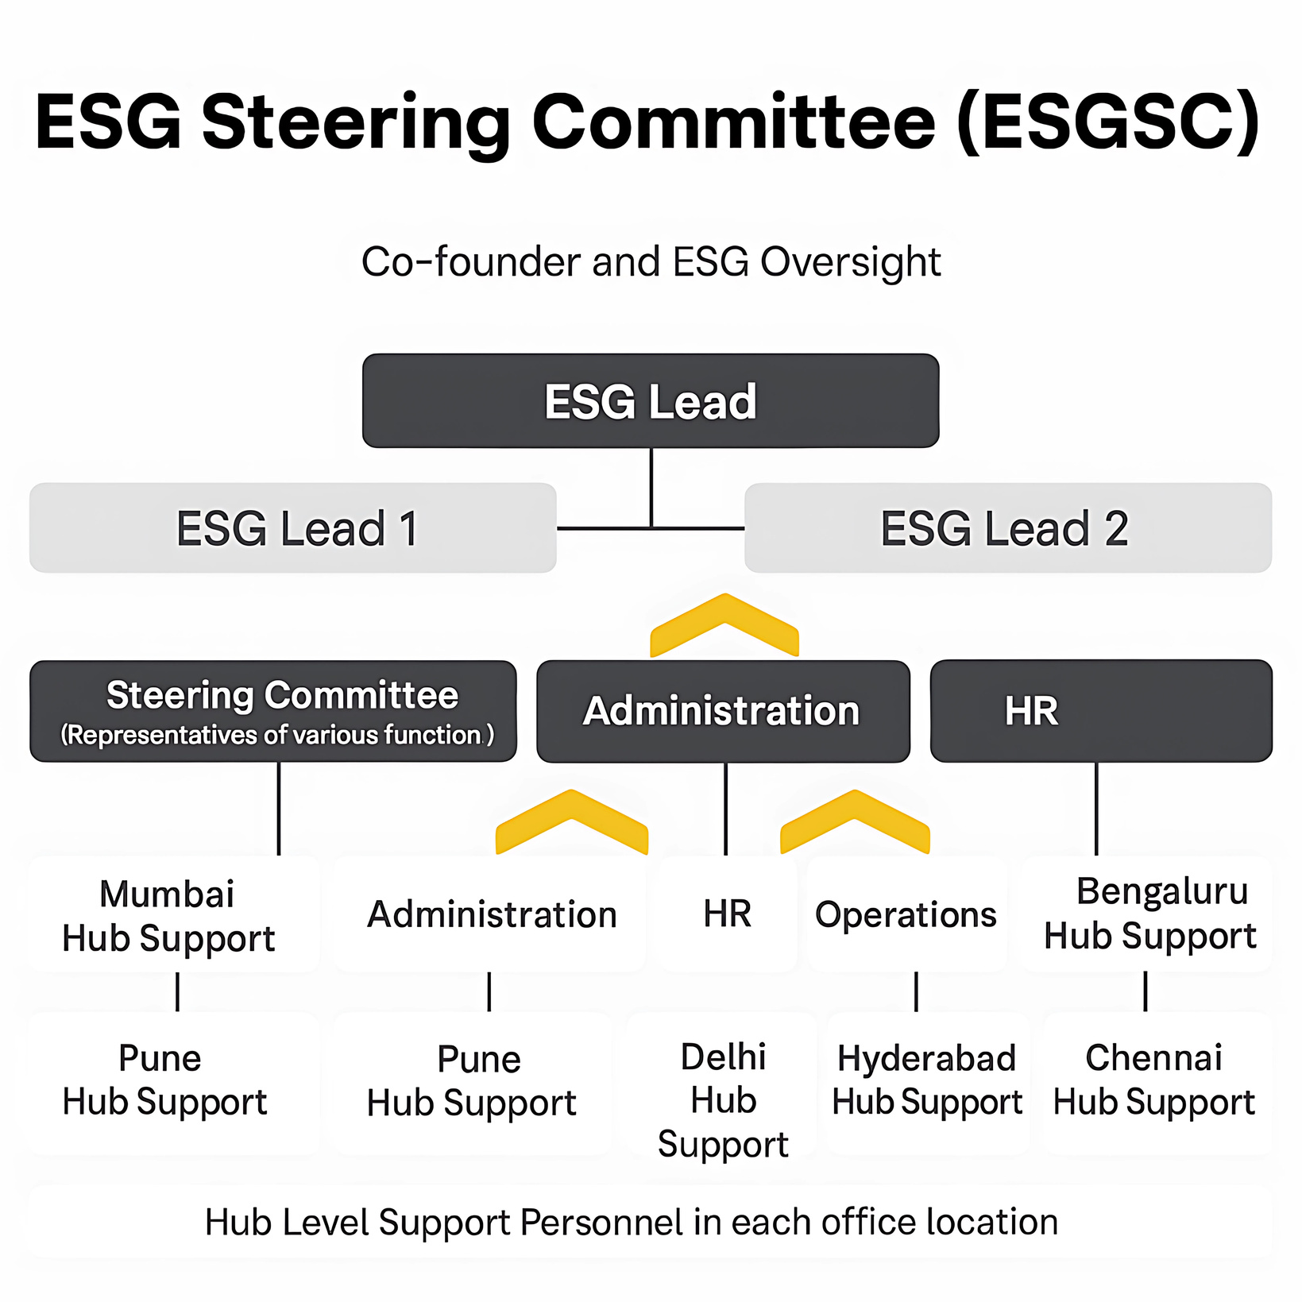
OUR ESG COMMAND CENTRE
ESG Policy
Introduction to the Policy
In today’s rapidly evolving corporate landscape, the integration of Environmental, Social, and Governance (ESG) principles into the core operations of a business is no longer optional but a vital choice to ensure sustainable growth. Everest is clear in its ambition to transition towards a greener, more inclusive and resilient business culture. As a leader in the fleet and mobility space, we recognize that our responsibilities extend far beyond business metrics, toward the betterment and well-being of our ecosystem, people, and planet.
Our ESG policy is a reflection of our dedication to our core ethos and toward the aspirations of our stakeholders – including clients, employees, partners, and the communities we operate in. Through this policy, we seek to communicate our values, action plans, and commitment to long-term value creation while reinforcing our role in building an equitable and sustainable future.
The policy represents a strategic and structured framework for environmental stewardship, guiding social development, and upholding governance standards. The goal is to ensure that our business does not only deliver financial returns but also catalyzes meaningful, long-lasting social and environmental impact.
Our Vision and Ambition
Everest Fleet management is entering into a transformation journey, underpinned by a mission to create long-term value, not only for its shareholders and stakeholders but for society as a whole.
Our ESG policy is designed to act as a blueprint for sustainable operations, aligned with global best practices and frameworks. We aim to operate responsibly, minimizing environmental harm while positively contributing to society and ensuring ethical conduct across all facets of our business.
Key ambitions of our ESG framework include:
Environmental Stewardship: Committed to reducing environmental impact by adopting eco-efficient technologies, waste reduction, and resource optimization.
Social Responsibility: Striving to build an inclusive culture by promoting diversity, supporting communities, and ensuring employee well-being and development.
Governance and Ethics: Embedding strong corporate governance principles and upholding transparency and accountability in all decision-making processes.
3 TIER ESG GOVERNANCE STRUCTURE
As part of our ESG efforts we have established a ESG Steering Committee to oversee, implement and assess our ESG initiatives.
Environmental, Social, and Governance
Steering Committee Charter
1. Purpose and Objectives
Everest has established an Environmental, Social and Governance Steering Committee (“ESGSC” or the “Committee”) to support the Company’s ongoing commitments to the environmental, health, and safety, corporate social responsibility, corporate governance, sustainability, and other relevant matters (collectively known as, “ESG Matters”).
The committee’s objective is to oversee ESG management and advise the Board of Directors in:
Setting Everest’s general strategy relating to ESG Matters, as well as developing, implementing, and monitoring initiatives and policies at the Company based on that strategy;
Overseeing communications with employees, investors, and other stakeholders of the Company concerning ESG Matters; and
Monitoring and anticipating developments relating to, and improving the Company’s understanding of, ESG Matters.
2. Membership
The members of the ESGSC will be approved by the Board of Directors of the Company (the “Board”) from time to time. The members of the ESG Committee will include such officers and employees of the Company as the Board deems appropriate, considering, among other things, such person’s expertise in relevant disciplines, including environmental, health, and safety, operations, legal, investor relations, corporate governance, finance, human resources, and communications. Unless the Board designates a Chair, the Committee may designate a Chair by majority vote of the full Committee membership.
3. Meetings, Procedures and Authority
The ESGSC has the authority to establish its own rules and procedures for notice and conduct of its meetings so long as they are not inconsistent with any provisions of the Company’s Memorandum and Articles of Association (as may be amended and/or restated from time to time, the “Memorandum and Articles of Association”) that apply to the Committee.
The Committee will meet as frequently as it deems necessary and advisable to carry out its duties, but no fewer than two times each calendar year. Members of the ESG Steering Committee may participate in meetings through telephone conferences or similar communications equipment by means of which all persons participating in the meeting can hear each other. The Committee may ask other officers and employees of the Company to attend the meetings or provide pertinent information as requested. The ESG Lead of the ESGSC (“ESG Lead”), or his or her designee, is responsible for scheduling and setting the agenda for meetings.
ESG STEERING COMMITTEE CHARTER
We have also developed the functional charter defining the roles and responsibilities of the ESG Management Committee.

Slide 22
SUPPLIER CODE OF CONDUCT AND ASSESSMENT
We have developed a supplier code of conduct to formalize and standardize our relationship with suppliers and value chain partners. Our focus is on environmental sustainability, creating value for the community and safeguarding assets & information.
Valuing people, communities, and the environment
We firmly believe in prioritizing the health and safety of all individuals involved in our supply chain, promoting diversity and inclusion, upholding human rights, and respecting labor rights in accordance with international standards. We are unwavering in our commitment to creating a workplace free from harassment and discrimination of any kind. Furthermore, we recognize the critical importance of protecting the environment and promoting sustainable procurement practices to minimize our ecological footprint.
SUPPLIER CODE OF CONDUCT
Introduction
At Everest Fleet, we acknowledge that you – our supply partners – are at the core of our ability to deliver world-class services to our clients and community. Indeed, our growth over the years is due in large part to your contribution. In this Code, we outline how we can continue working together by ensuring you meet our ethical expectations and minimum environmental, social and governance standards. Thank you for the work you do and the professional service you provide to Everest Fleet and our clients.
Purpose and scope
We recognize the critical role our suppliers play in ensuring the efficiency, safety, and sustainability of our operations. Our Supplier Code of Conduct serves as a guiding framework to foster ethical, responsible, and sustainable practices throughout our supply chain. Here are the key objectives and purposes of our Supplier Code of Conduct:
1. Ethical Standards: We expect our suppliers to uphold the highest ethical standards in all their business dealings, including honesty, integrity, and transparency.
2. Labor Rights and Standards: We require our suppliers to respect and uphold the labor rights of their workers following international standards set by the International Labor Organization (ILO). This includes providing fair wages, safe working conditions, and prohibiting child labor and forced labor
.
3. Environmental Responsibility: We are committed to minimizing the environmental impact of our operations and expect our suppliers to share in this commitment. Our suppliers must comply with environmental regulations, minimize energy consumption, and adopt sustainable practices to reduce waste generation.
4. Quality and Safety: We prioritize the safety and quality of our fleet and services. Our suppliers are expected to deliver products and services that meet our rigorous quality and safety standards, ensuring the reliability and safety of our operations.
5. Ethical or non-compliant practices: This includes risks related to reputational damage, legal liabilities, and disruptions to the supply chain.
6. Stakeholder Trust and Reputation: Upholding ethical and responsible business practices strengthens stakeholder trust and enhances our role as a socially responsible fleet operator. Your commitment to responsible procurement builds confidence among clients, investors, and the community.
7. Continuous Improvement: We believe in continuous improvement and encourage our suppliers to strive for excellence. Our Supplier Code of Conduct includes mechanisms for monitoring, evaluation, and feedback, fostering a culture of continuous improvement and collaboration across our supply chain.
By aligning with our Supplier Code of Conduct, suppliers become integral partners in our mission to deliver sustainable, safe, and efficient fleet management solutions while upholding the highest standards of corporate responsibility. Together, we can drive positive change and create lasting value for our stakeholders and the communities we serve.
Scope and Applicability
The Everest Fleet team goes beyond our employees - it extends to all third-party and supply partners who help us deliver on our promise to our clients. We developed this Code for you, our partners, to set out our business conduct and ethical expectations of you as well as your employees, agents, and sub-contractors (collectively “supply partners”). All supply partners must comply with this Code while conducting business for or on behalf of Everest Fleet. Our compliance expectations include implementing policies, procedures and training as well as taking preventative and remedial action to avoid and correct gaps.
Valuing people, communities, and the environment
We firmly believe in prioritizing the health and safety of all individuals involved in our supply chain, promoting diversity and inclusion, upholding human rights, and respecting labor rights in accordance with international standards. We are unwavering in our commitment to creating a workplace free from harassment and discrimination of any kind. Furthermore, we recognize the critical importance of protecting the environment and promoting sustainable procurement practices to minimize our ecological footprint.
Health & Safety
At Everest Fleet, we place paramount importance on safeguarding the health and safety of all personnel involved in our operations, including those of our vendors and suppliers. All individuals must be adequately trained, certified, and equipped to execute their duties safely, minimizing risks not only to themselves but also to others directly or indirectly affected by their actions. We mandate the identification, assessment, and elimination or management of any potential risks to worker health or safety throughout all sourcing, supplier, and service provision activities. Continuous improvement in safety performance is expected through regular review and enhancement of safety programs and practices, ensuring ongoing compliance and protection for all stakeholders.
Doing business with Integrity
Everest places a high value on doing business with integrity. It strictly prohibits the receipt, offer, or payment of bribes, kickbacks, facilitation payments, or the exchange of anything of value (directly or indirectly) intended to advance Everest’s business interests or provide undue or improper advantages for Everest or its partners. While it may sometimes be appropriate to exchange gifts or offer entertainment, suppliers should not use these business courtesies to gain an improper advantage or preferential treatment. Suppliers should ensure that gifts or entertainment are modest in value, infrequently provided, and consistent with local law and the internal rules of the recipient’s employer. Gifts of cash or cash equivalents, such as gift cards, are not allowed.
Safeguarding Assets, Information and Interests

Slide 23

PEOPLE AND PARTNERSHIPS

Slide 24





STAKEHOLDERS AT THE HEART OF OUR JOURNEY
DRIVERS
EMPLOYEES
CLIENTS AND INVESTORS

Slide 25
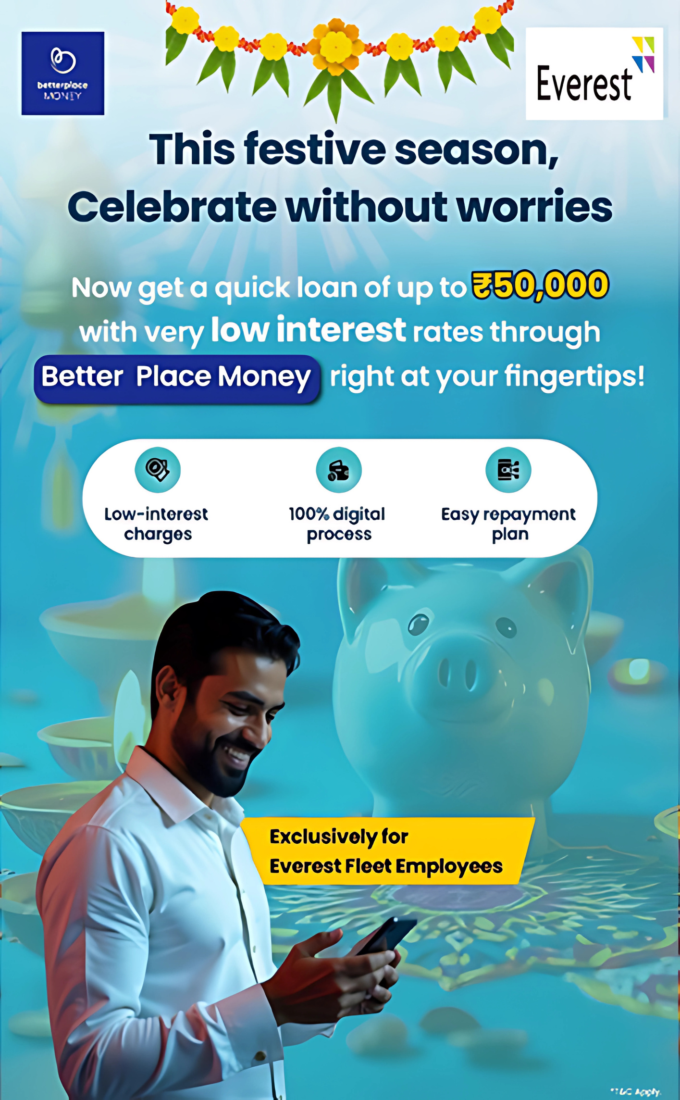
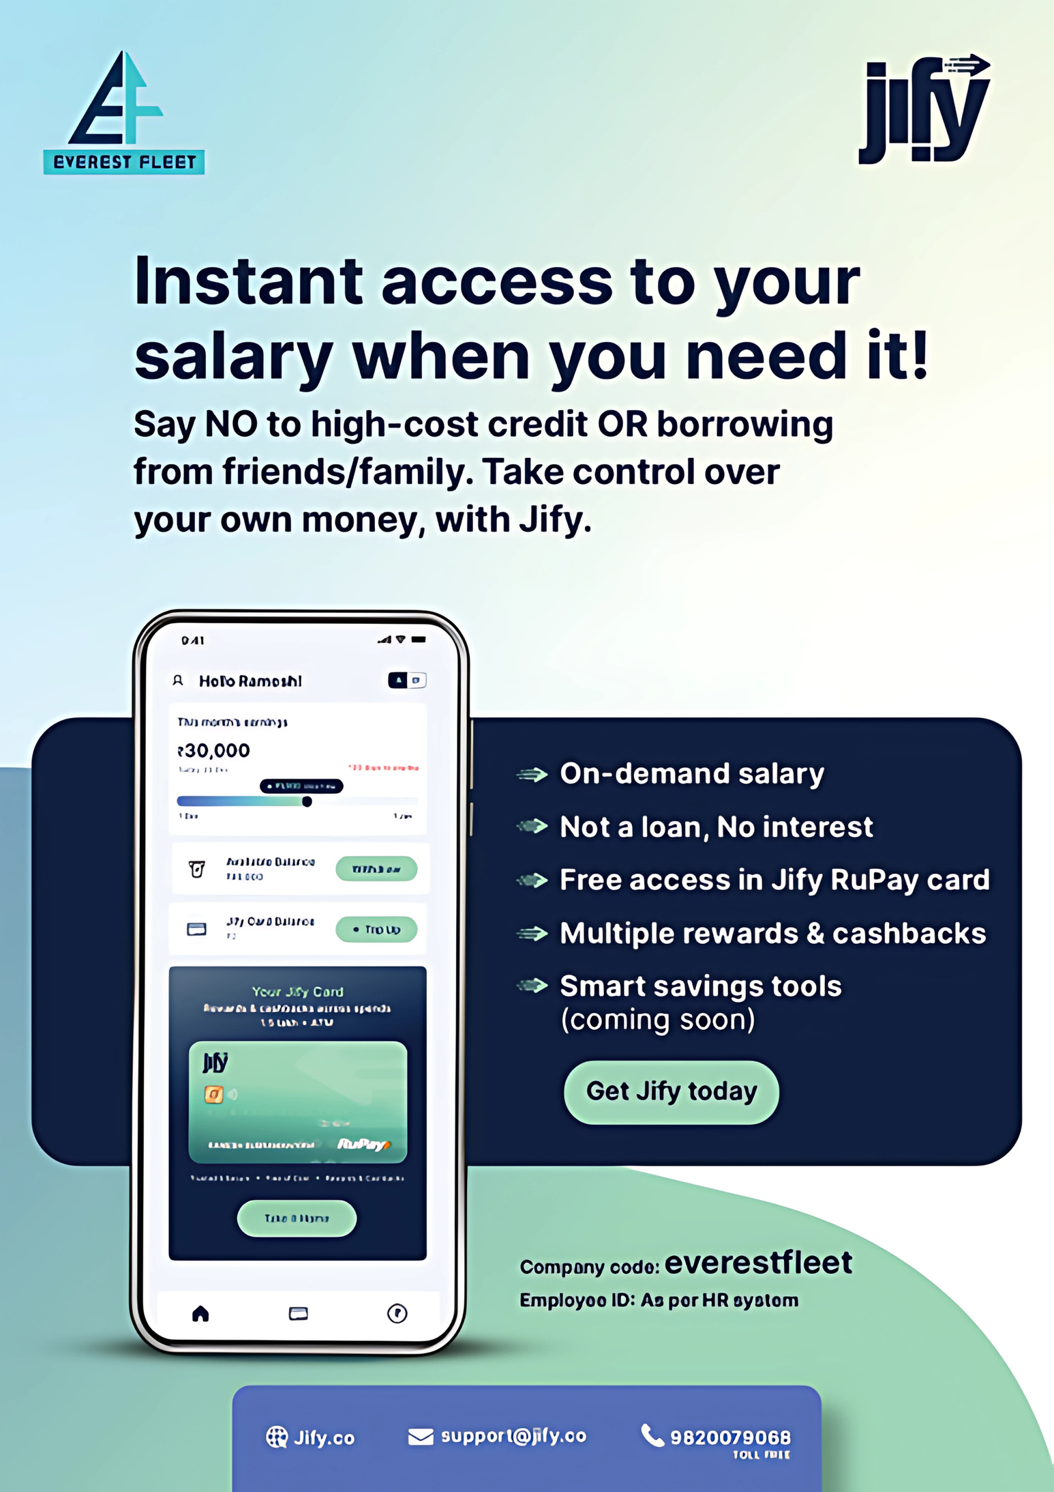
EMPLOYEES
ADVANCED SALARY
LOAN
BETTER PLACE MONEY
Employees can avail of a loan of up to ₹50,000 with low-interest rates through Better Place Money just at your fingertips! Offer Highlights:
• Low-Interest Charges
• 100% Digital Process
• Easy Repayment Plans

Slide 26
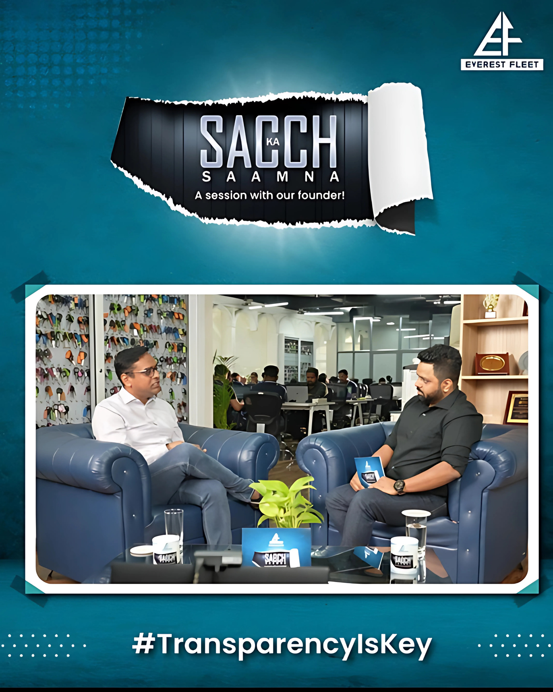
EMPLOYEE SURVEYS
ENCOURAGING TRANSPARENCY
Employee Voices Matter
Initiating organization-wide surveys proactively to ensure alignment with the right direction
Employee Satisfaction
Training and development needs
Improving feedback mechanisms
Unfiltered Truths: Sach Ka Saamna with Our Founder
In these sessions of ‘Sach Ka Saamna’ employees have the opportunity to ask our founder anything without hesitation. The open forum leads to candid responses and valuable insights, reinforcing our culture of transparency and honesty.”

Slide 27
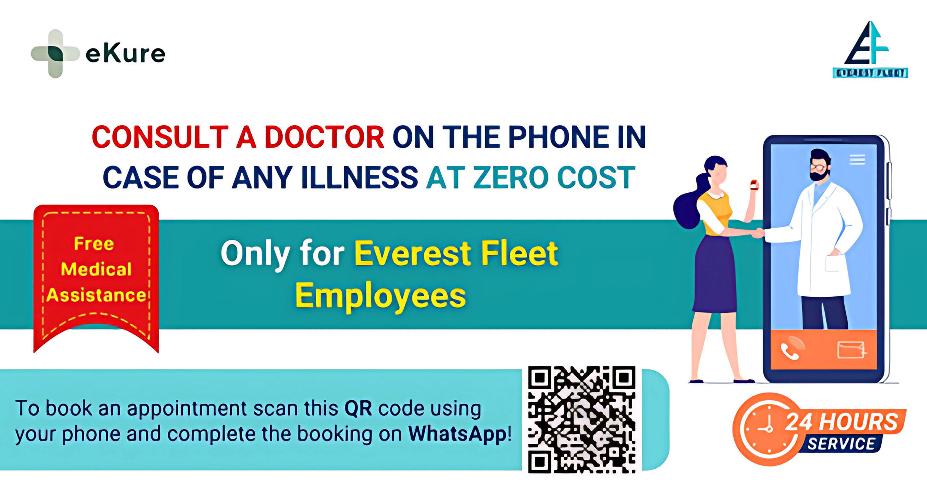



EMPLOYEES
Employee Benefits
Medical Insurance
SILVER COIN : New Born Baby Gift
RS 5000 : Marriage Gift
LONG SERVICE AWARD : On completion of 10 Years
Introduced eKure to ensure on demand healthcare service for our Pilots and Employees

Slide 28
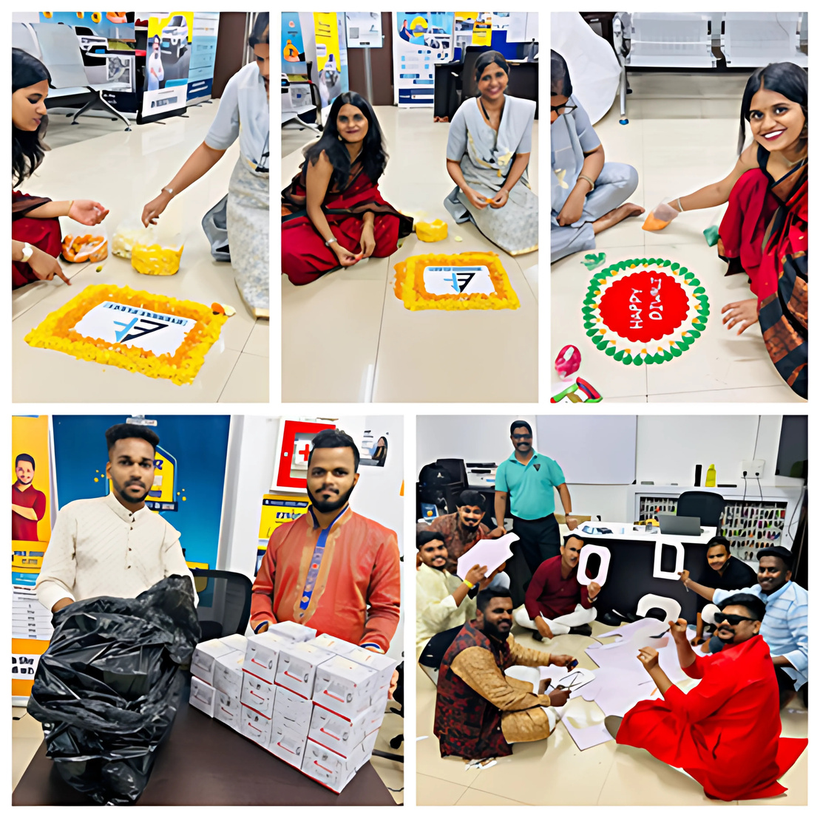
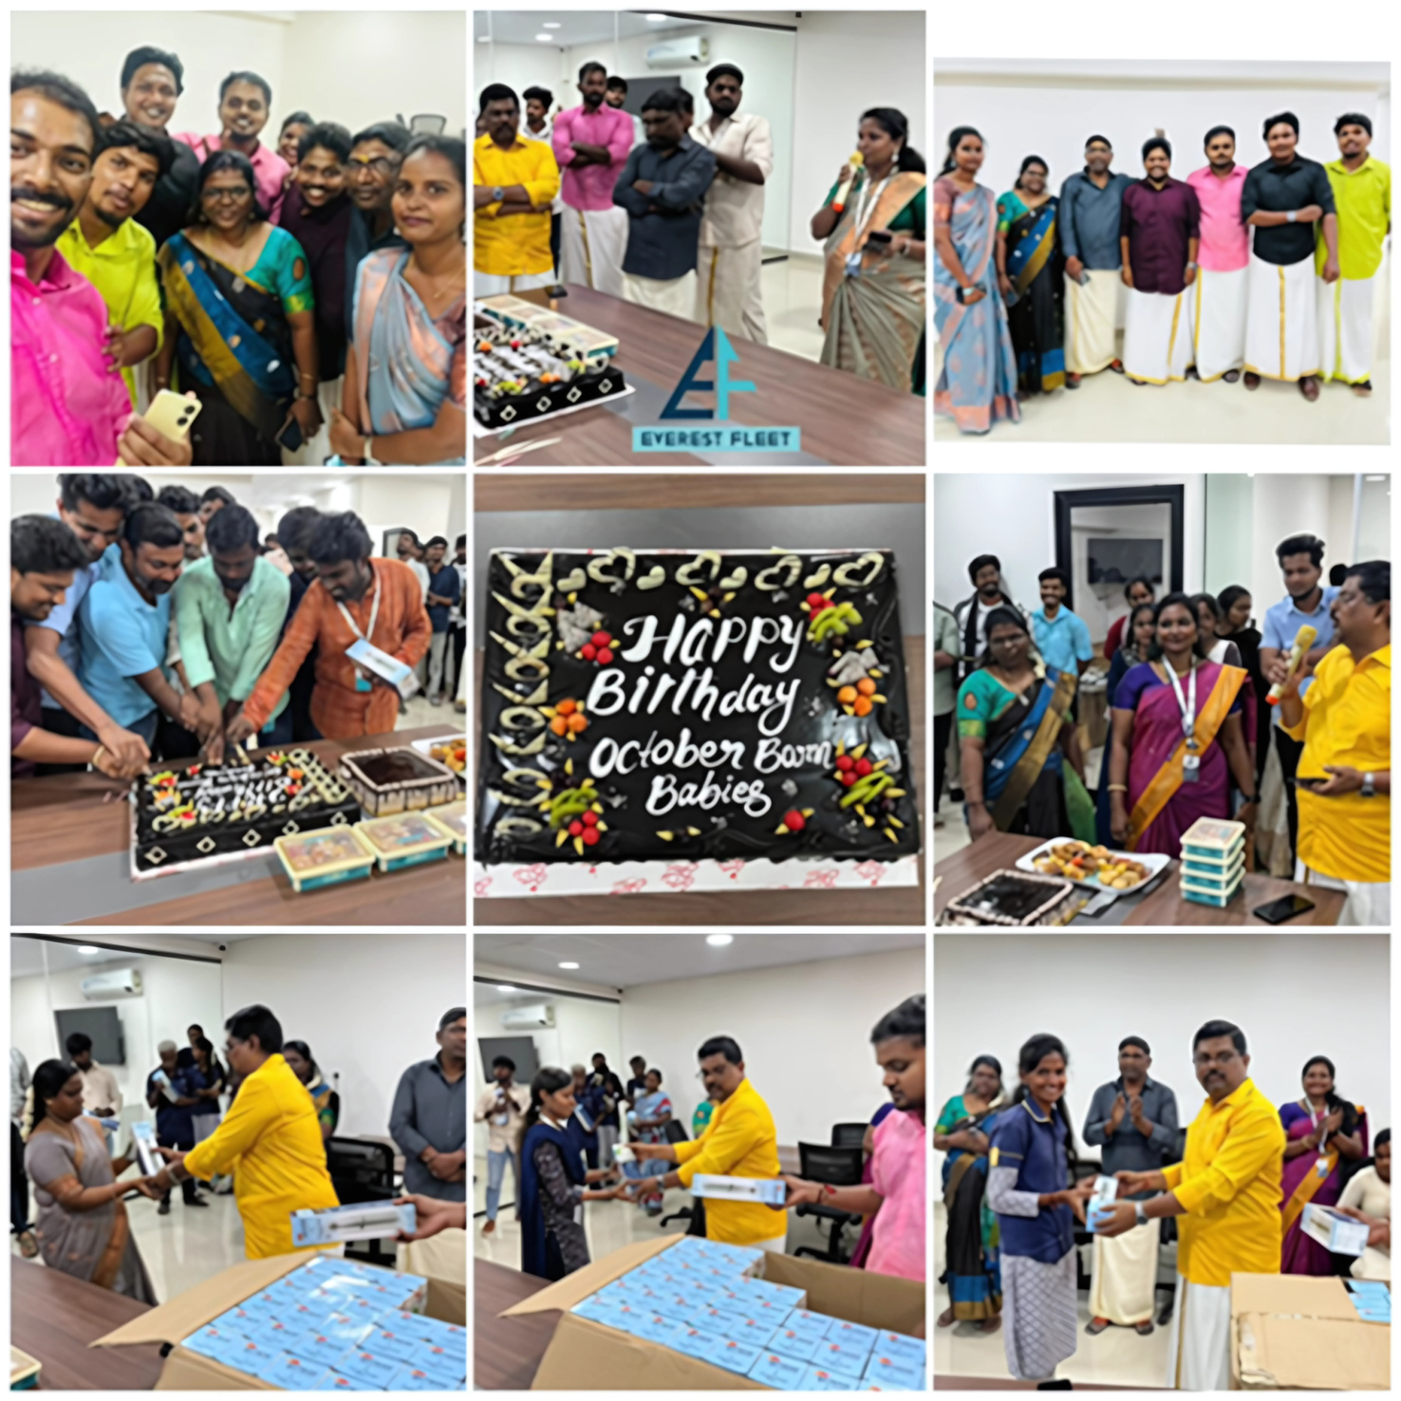
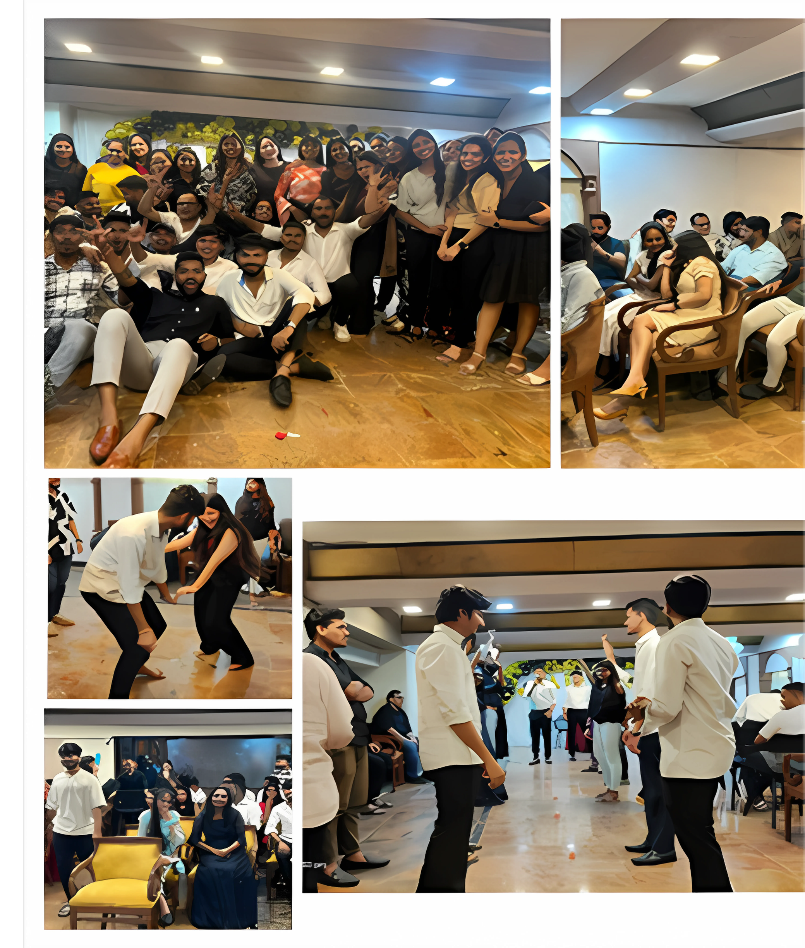

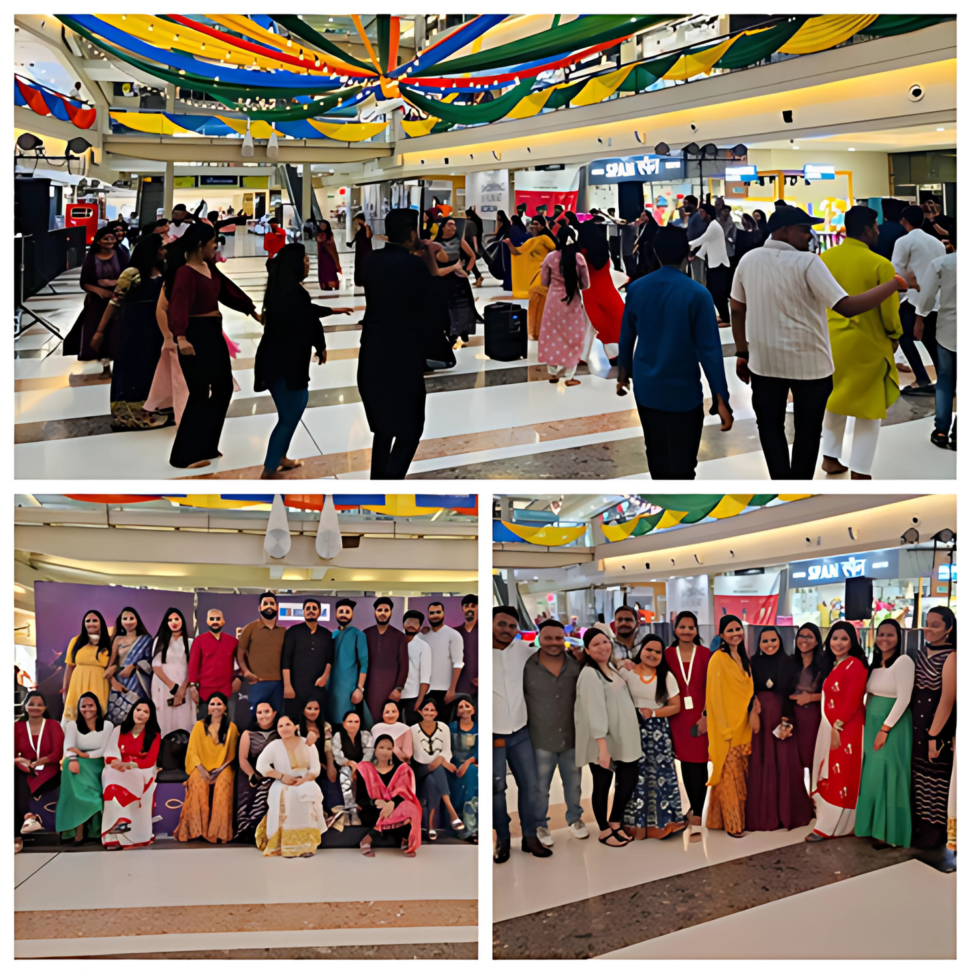
EMPLOYEE ENGAGEMENT PROGRAM
Discretionary Spend Allowance

Slide 29
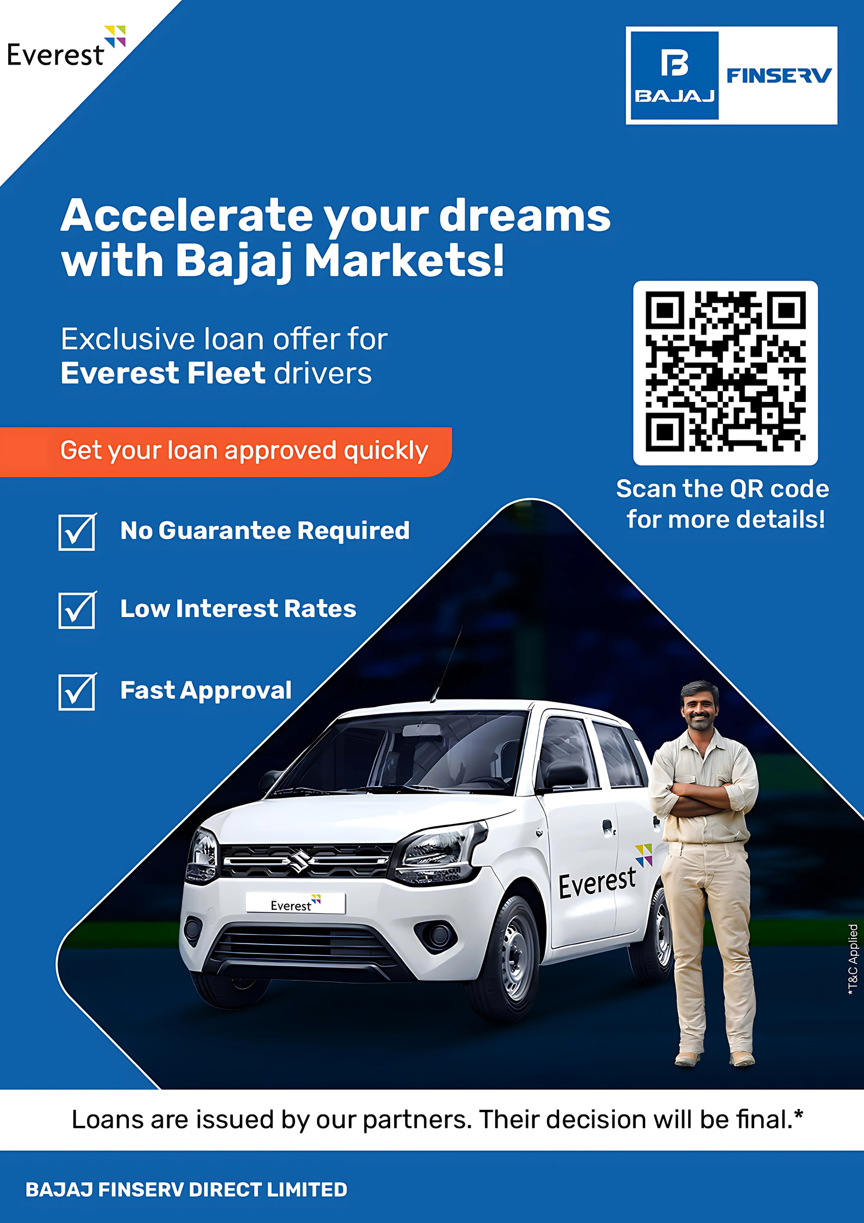
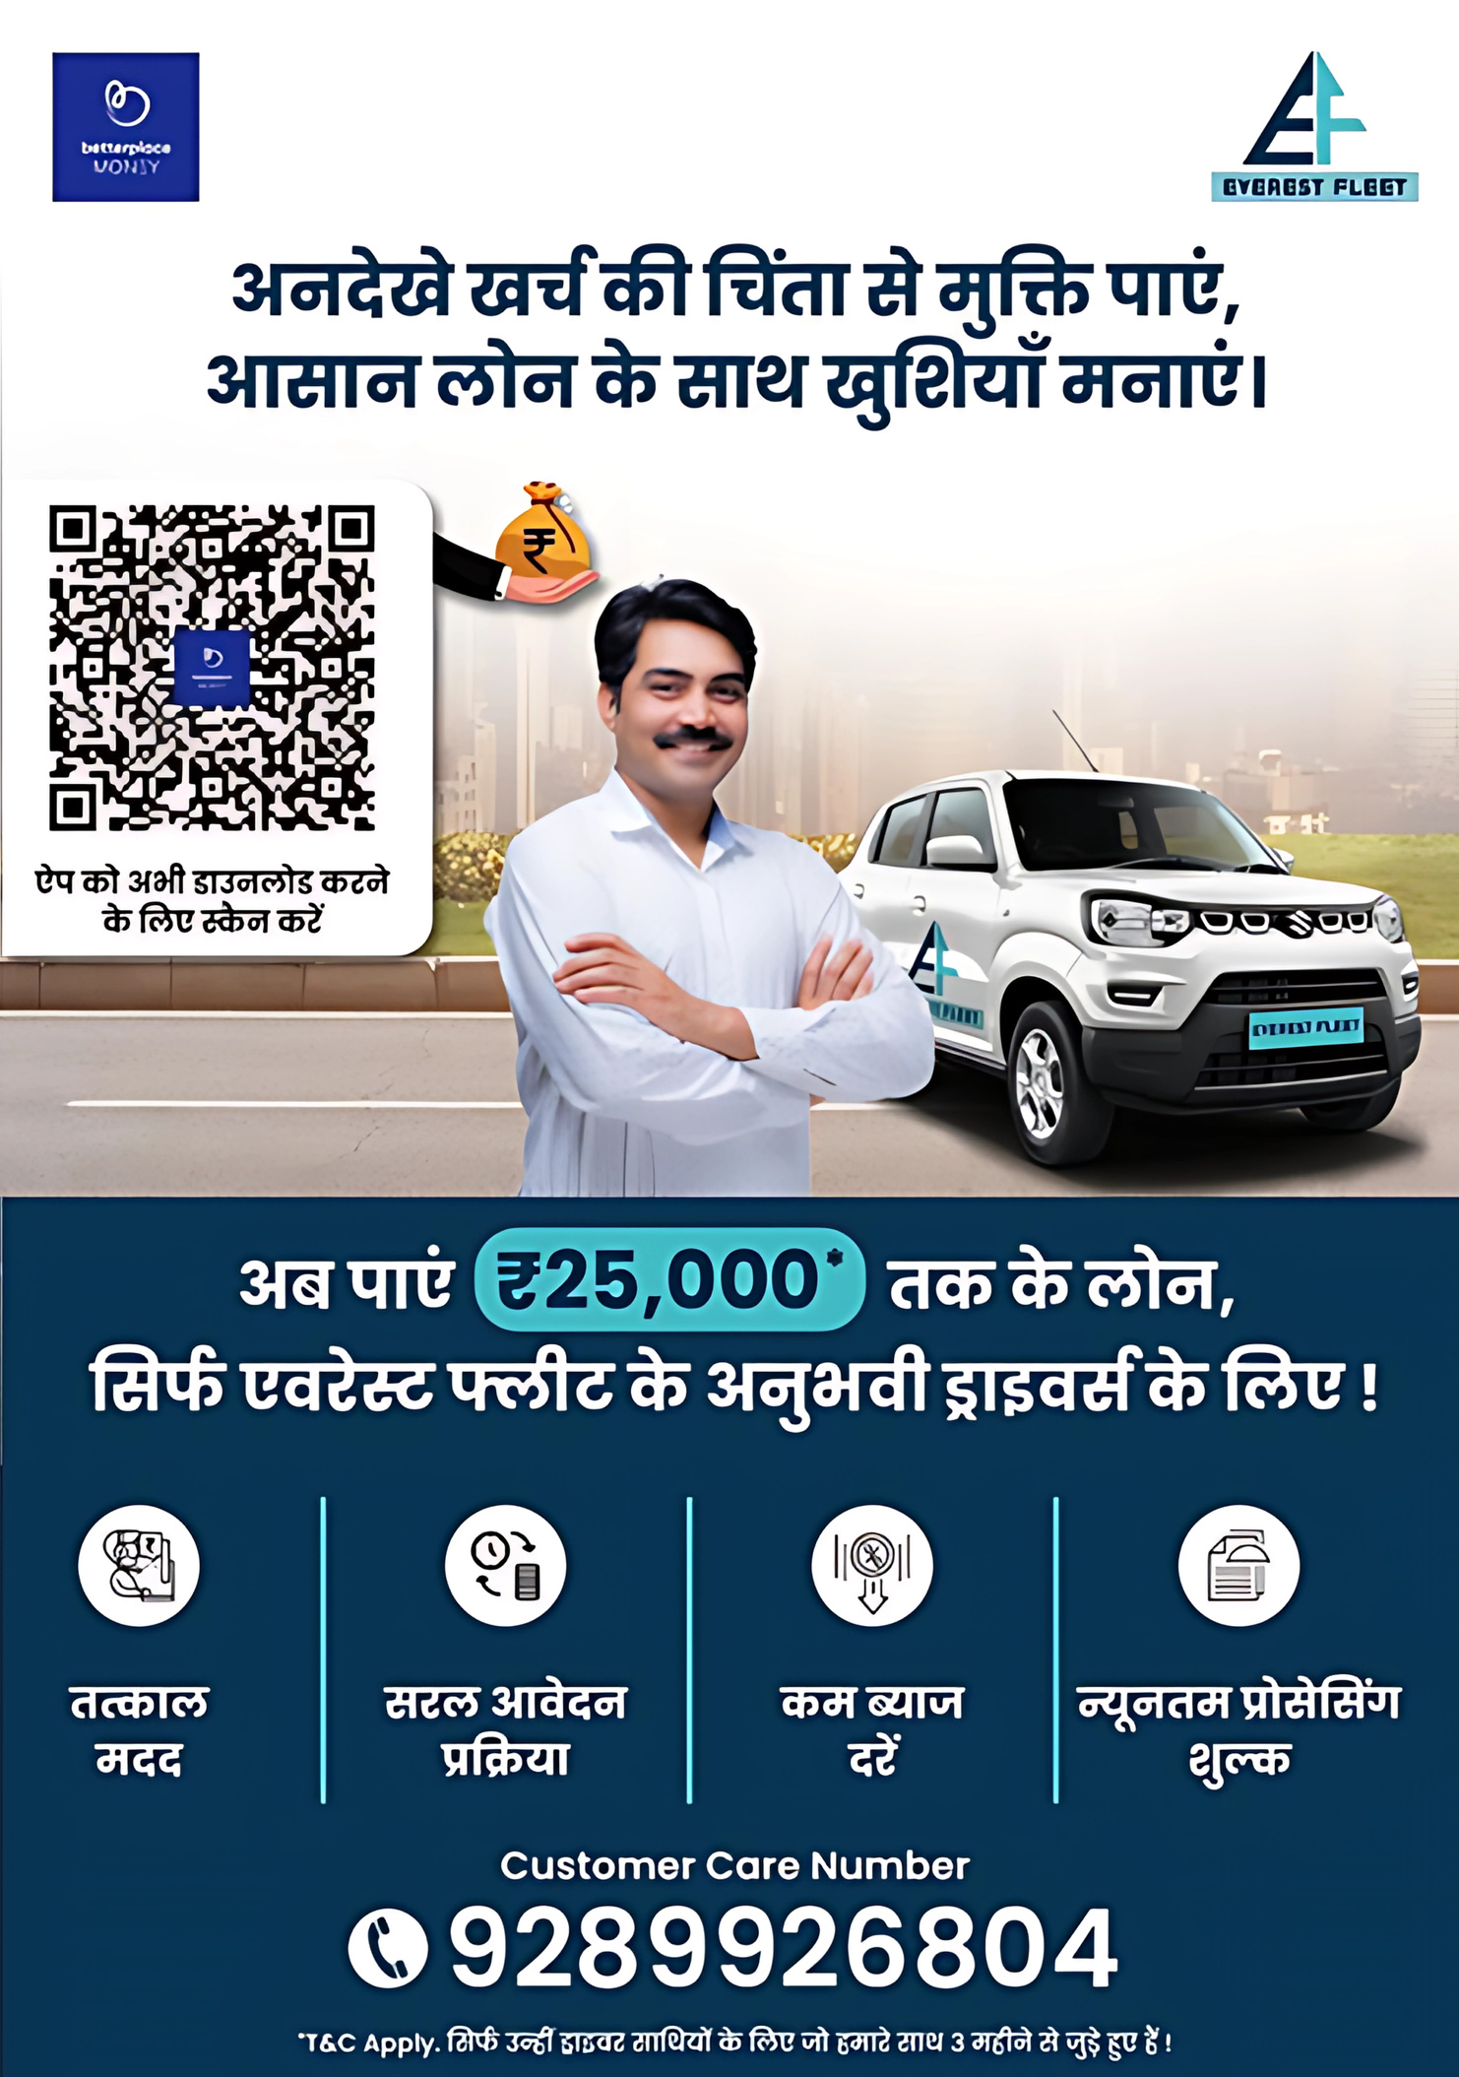
DRIVERS: INITIATIVES AND STORIES
EASY LOAN -BAJAJ FINSERV
Driver Finance – Better place Money For old active drivers
Successful pilot in Mumbai,
targeting approx. 1,405 drivers who had completed at least 90 days with EF.
Now with increased access to loan facilities:
Targeting Active Driver who has completed 30 days with us

Slide 30
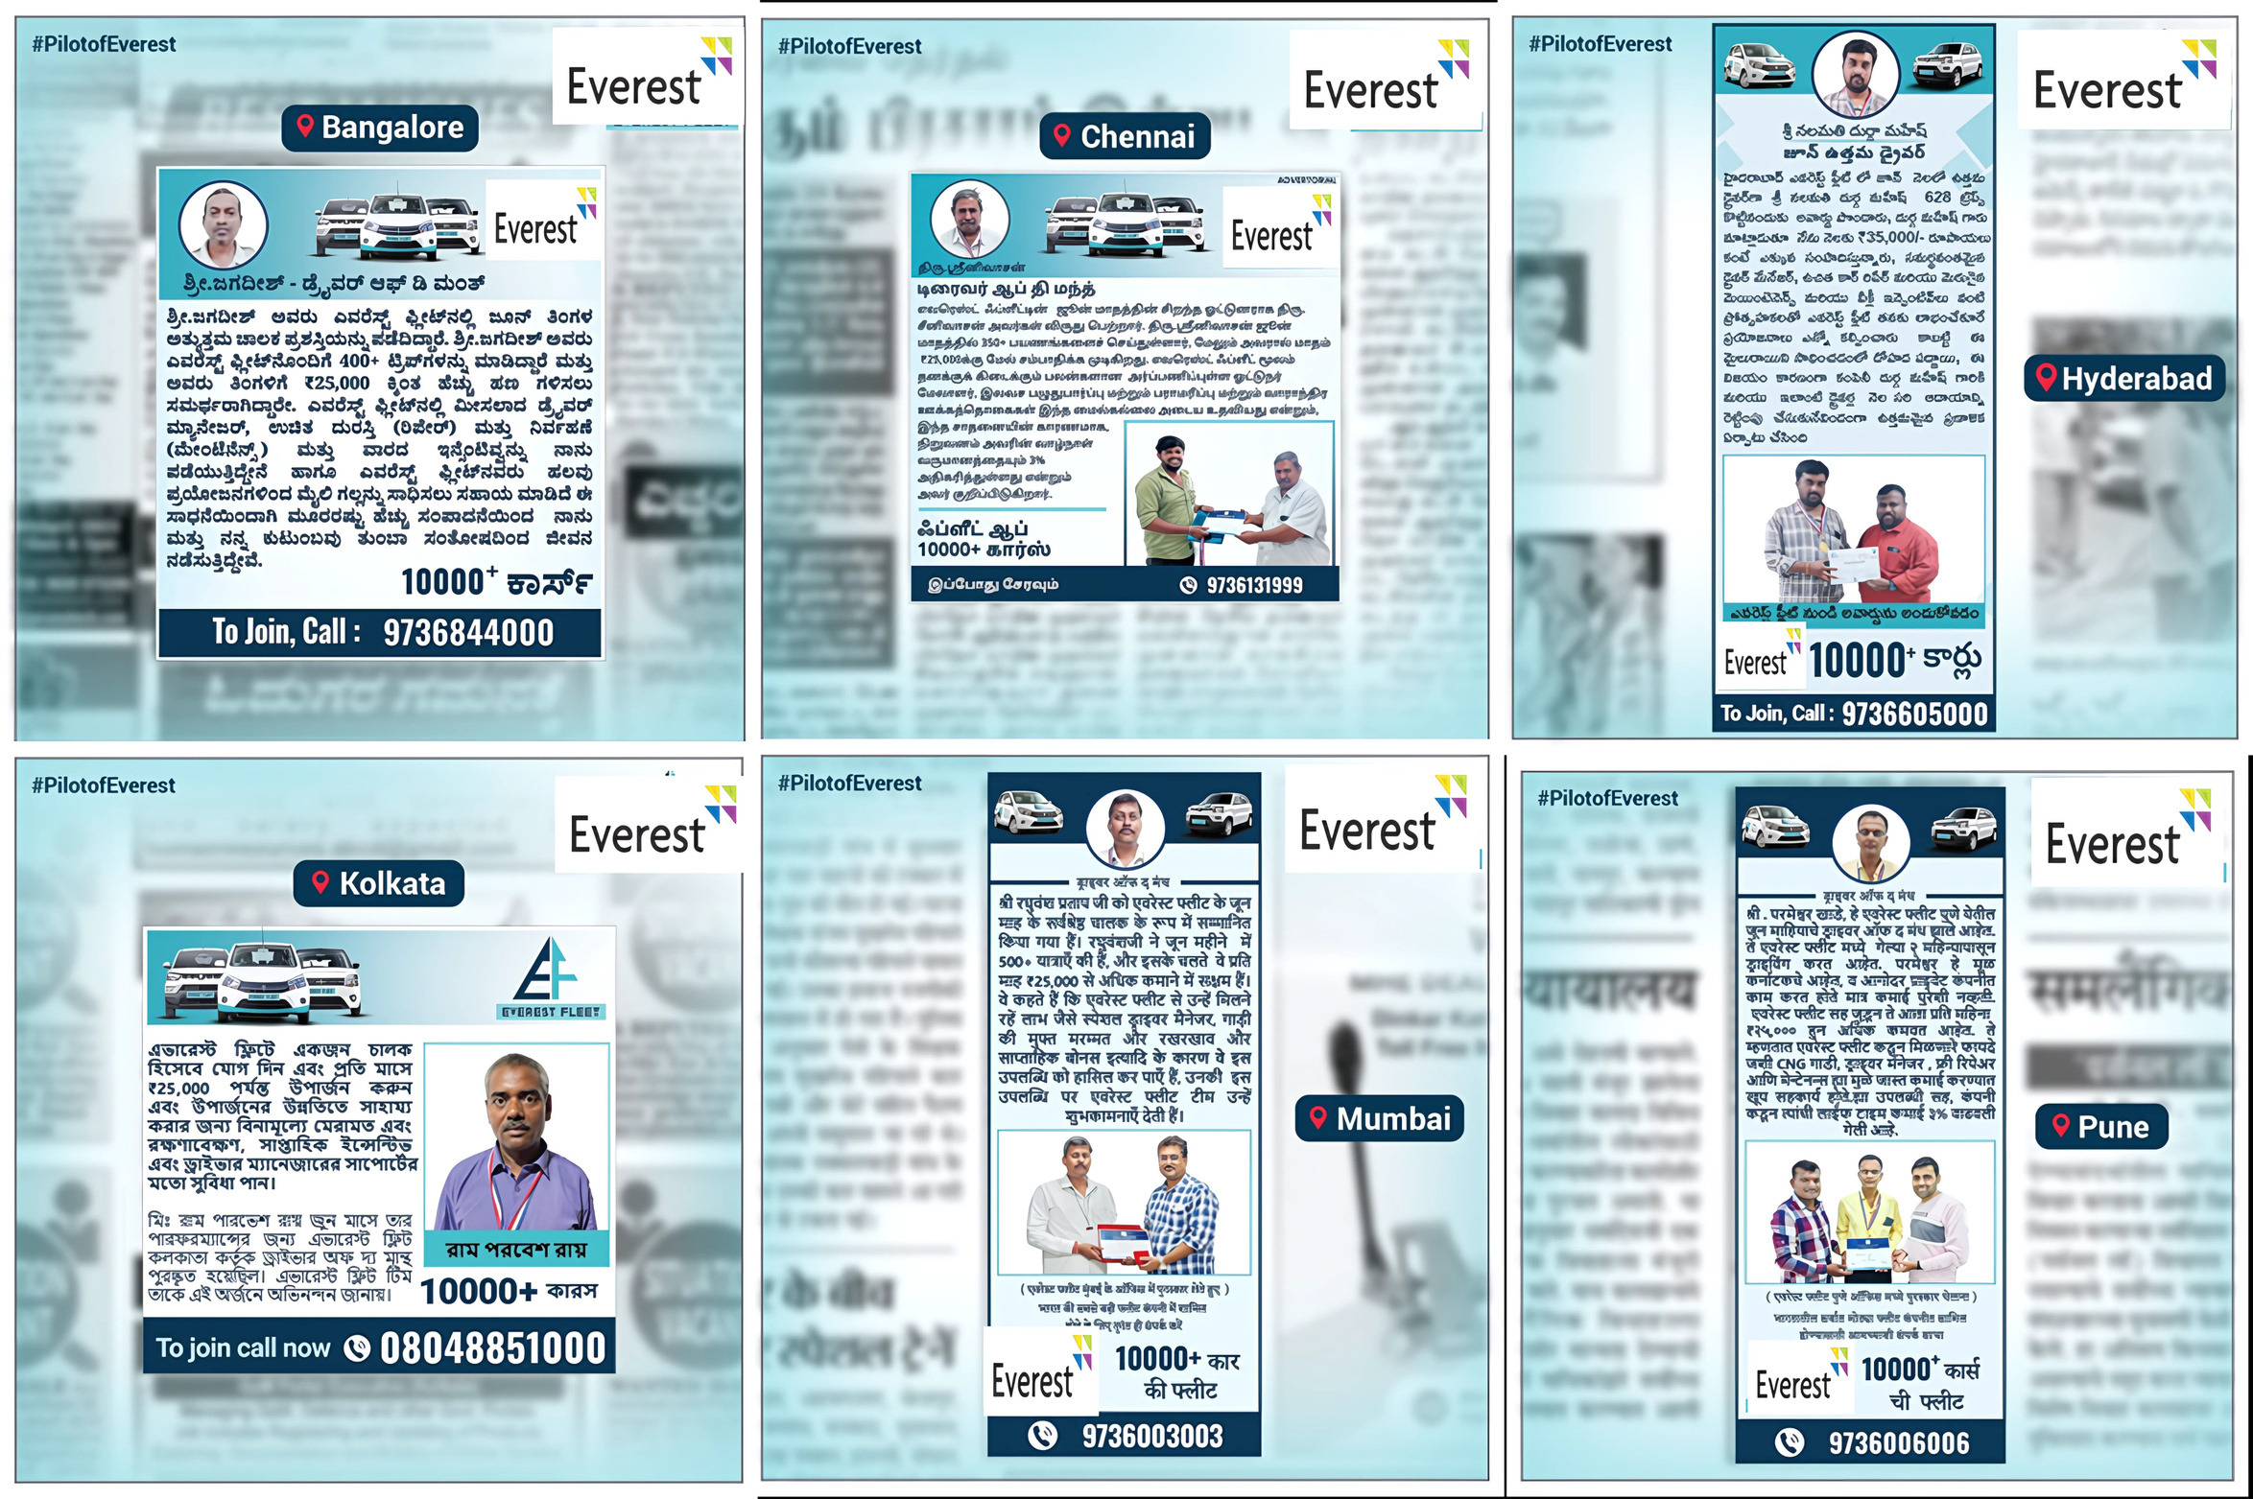
MONTHLY PILOT RNR’s
Recognizing our Best Pilots across all the cities.

Slide 31
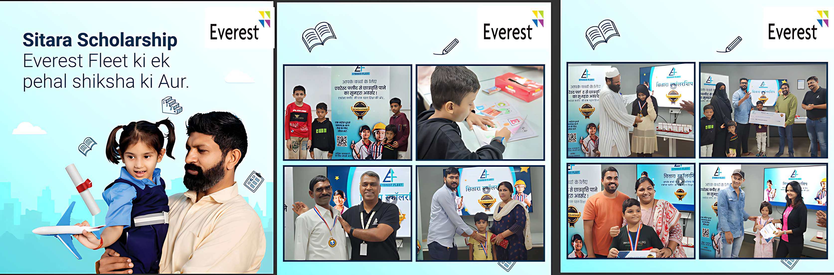
SITARA
Lighting the Path for Tomorrow’s Stars
Driving Dreams, Fueling Futures: Sitara Scholarship Initiative empowers our pilot's children, unlocking a world of possibilities for them.

Slide 32

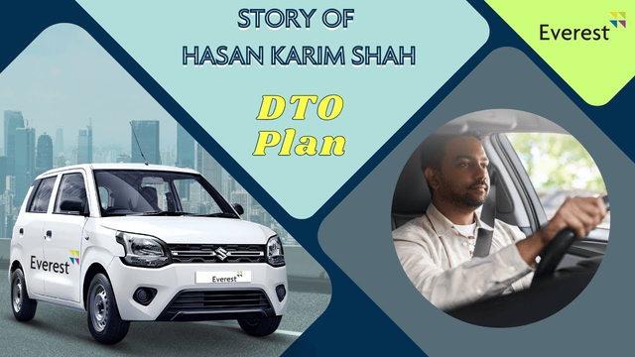
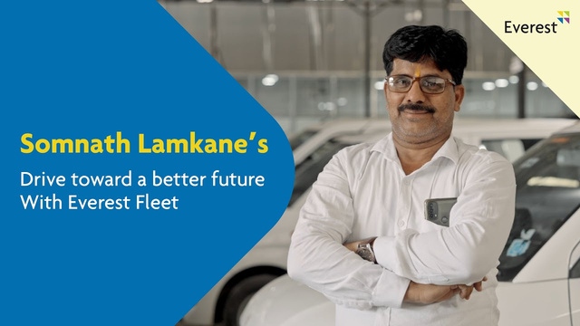
CLIMBERS OF EVEREST: SCALING DREAMS ON YOUTUBE
To amplify and highlight their efforts, we have started an outreach series called ‘Climbers of Everest’ which puts the spotlight on these heroes for others to be motivated and take inspiration from.
DRIVER SUCCESS STORIES:
Explore inspiring narratives of Everest Fleet drivers overcoming challenges and achieving milestones, showcasing their dedication and professionalism
Hear firsthand accounts of drivers' experiences with Everest Fleet, highlighting the company's supportive culture and opportunities for growth
TESTIMONIALS:
Discover testimonials from satisfied drivers who have experienced the benefits of partnering with Everest Fleet Management, emphasizing the company's commitment to driver satisfaction and success.
Learn how Everest Fleet's innovative solutions and supportive environment have positively impacted drivers' careers and livelihoods, as shared through authentic testimonials on the channel.
MARKETING CONTENT:
Engage with marketing materials that showcase Everest Fleet's services and competitive advantages, demonstrating the company's commitment to providing exceptional fleet management solutions.
Explore how Everest Fleet's marketing efforts effectively communicate the value proposition to both drivers and potential clients, highlighting the benefits of partnering with the company for transportation needs.
I
N
S
P
I
R
I
N
G
S
T
O
R
I
E
S
TAP THE IMAGE TO HEAR SOMNATH’S STORY

Slide 33

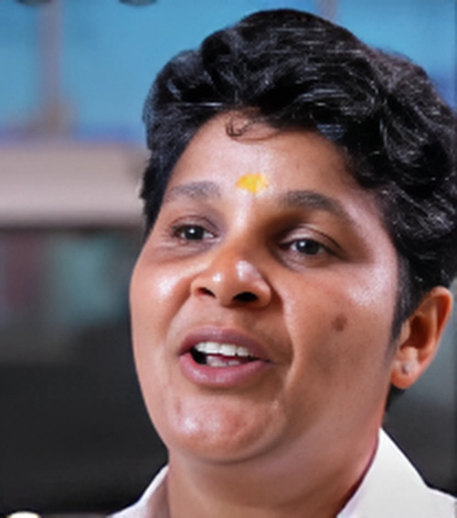
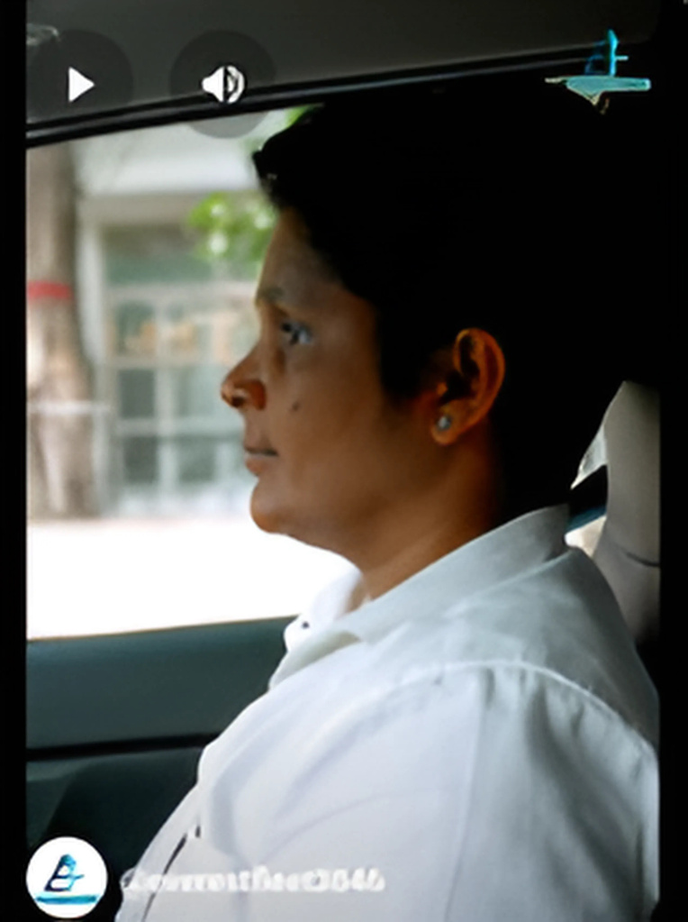
MEET RANI: EF’S FIRST FEMALE DRIVER FROM CHENNAI
HOW HER LIFE TRANSFORMED AFTER JOINING EVEREST…..
Rani, a determined and skilled woman, embarked on a life-changing journey with Everest Fleet Management Company’s Driver program. Initially facing barriers and stereotypes in the male-dominated transportation industry, Rani found empowerment and support through Everest’s women driver recruitment initiative.
The program provided her with specialized training, advanced technology tools, and a supportive community of fellow female drivers. With newfound skills and confidence, Rani excelled in her role, surpassing performance metrics and setting new standards for safety and efficiency. The program's emphasis on work-life balance and career growth opportunities enabled Rani to achieve financial stability and personal fulfilment.
Her inspiring success story not only shattered gender norms but also inspired other women to pursue careers in transportation, making Rani a beacon of empowerment and change in the industry.
Rani was working in the seafood industry as a production manager. She was facing issues in continuing her job due to personal constraints as her mother was ill. After incessantly searching for better economic opportunities, she learnt to drive. However, after joining as a driver in her previous company, she had unsustainable working conditions She then heard of Everest and joined as a self-entrepreneur and driver. And has been driving since 20XX.
TAP THE IMAGE TO HEAR RANI’S STORY
MAJOR ADVANTAGES OF JOINING AS EVEREST DRIVER :
TAP ON THE P
Career Development Opportunities: Opportunities for career advancement, including mentorship programs and leadership training, enabled Rani to set ambitious goals, acquire new skills, and progress towards higher roles within the company.
Advanced Technology Tools: Access to modern technology tools, such as GPS navigation systems and real-time monitoring apps, empowered Rani to optimize her routes, improve efficiency, and ensure timely deliveries.
Specialized Training: Rani benefited significantly from specialized training programs tailored to enhance her driving skills, safety knowledge, and customer service expertise.

Slide 34
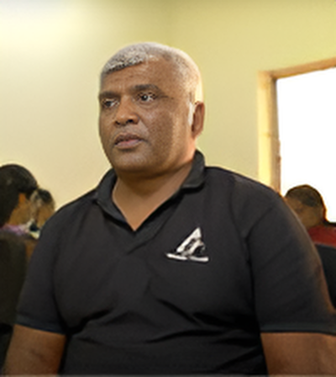
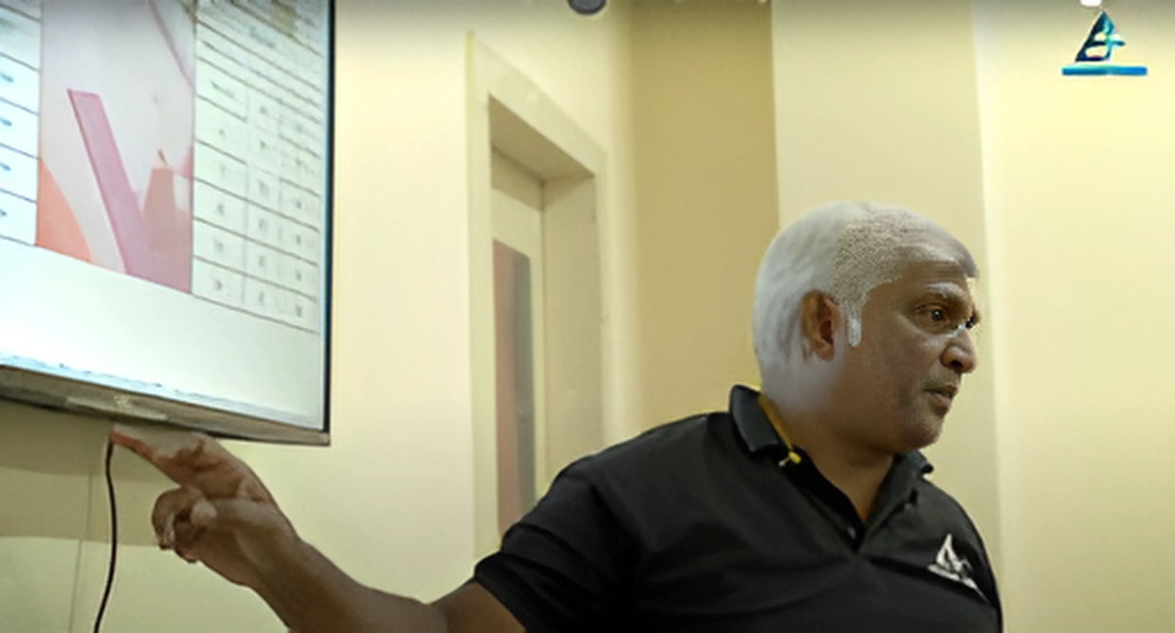
FROM DRIVER TO EXPERT TRAINER: MEET LAKSHMAN
At Everest, Lakshman leverages his extensive experience and skills to train and mentor new drivers, ensuring they are well-equipped to excel in their roles and uphold the company's standards of excellence.
Before joining Everest, he worked with Ola as a leasing executive, where he adeptly managed a fleet of 200-500 vehicles over a span of three years. This role honed his skills in vehicle management, operational efficiency, and customer service. Coming from a close-knit family of five, including his brother, sister, father, and wife, Lakshman understands the importance of responsibility and teamwork. His educational journey culminated in completing his 2nd PUC, providing him with a solid foundation of knowledge
“I work 7-8 Hours a day and now have time for my family, meditation and myself. I feel a sense of fulfilment and achievement like never before”
Everest has invested its time and resources in upskilling us, especially people who have switched from different work streams. Their constant support and prioritizing driver well-being is the biggest asset for us.
HIS ACHIEVEMENTS SO FAR.....
He has total 9 years of experience including Everest fleet
He was the winner of EPL and got promoted to SDM

Slide 35

STRENGTH IN UNCERTAIN
TIMES
STORY OF SHAIKH UAIZ
HIS STORY
Shaik Uaiz's journey at Everest Fleet Company is a testament to the transformative power of dedication and opportunity. Starting as a driver manager, Shaik displayed exceptional leadership and operational acumen, earning him a promotion to Assistant Operations Manager. His commitment to excellence and innovative problem-solving skills led to streamlined processes, improved driver performance, and enhanced customer satisfaction. Shaik's rapid career progression not only reflects Everest's commitment to nurturing talent but also underscores his ability to adapt, learn, and thrive in a dynamic environment. His story inspires others to seize opportunities, embrace challenges, and pursue professional growth with determination and passion.
Before joining Everest, he worked with Ola as a leasing executive, where he adeptly managed a fleet of 200-500 vehicles over a span of three years. This role honed his skills in vehicle management, operational efficiency, and customer service. Coming from a close-knit family of five, including his brother, sister, father, and wife, Lakshman understands the importance of responsibility and teamwork. His educational journey culminated in completing his 2nd PUC, providing him with a solid foundation of knowledge. At Everest, Lakshman leverages his extensive experience and skills to train and mentor new drivers, ensuring they are well-equipped to excel in their roles and uphold the company's standards of excellence.
UPSKILLING
CAREER DEVELOPMENT OPPURTUNITES
FULFILLING LIFE THROUGH REWARDING JOB

Slide 36


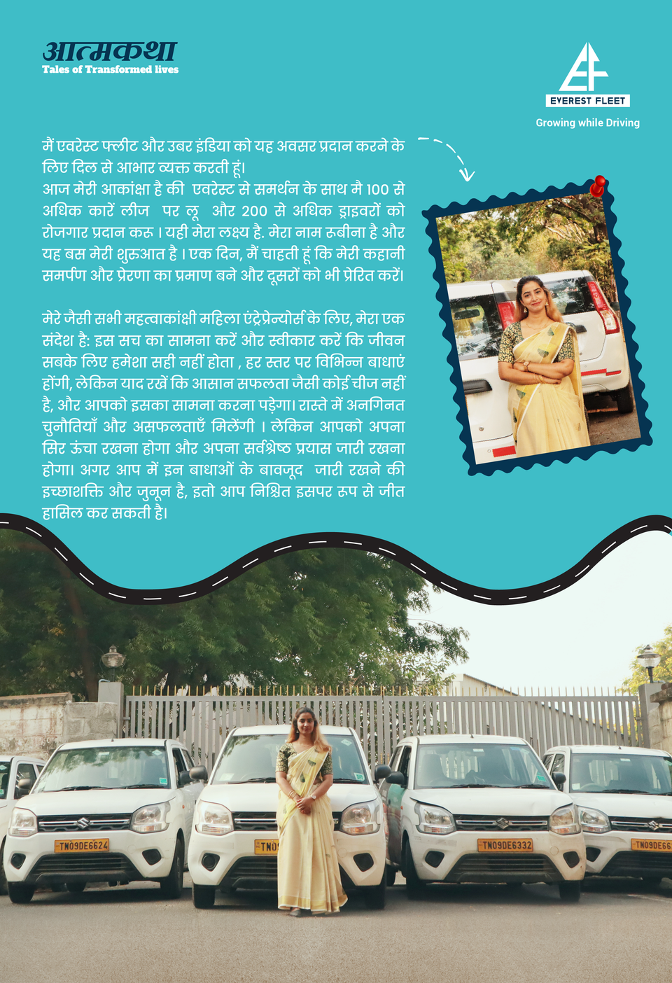
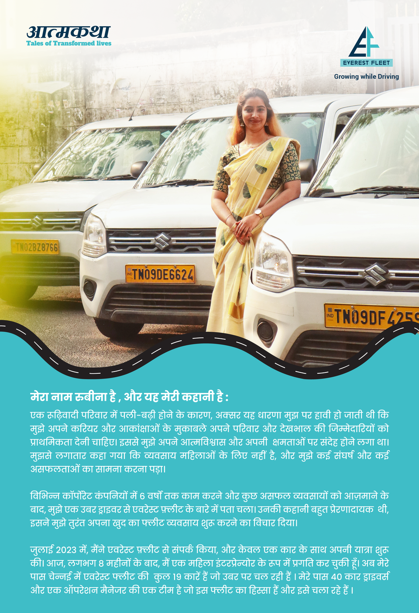
ATMA KATHA: STORIES FROM WITHIN

Slide 37

DISCLOSURES AND STANDARDS

Slide 38
GRI: DISCLOSURES AND STANDARDS
GRI STANDARD | DISCLOSURES | DETAILS
GRI 2: General Disclosures 2021 | 2-7 Employees | As of the reporting period, our total workforce comprises 4,265 individuals across various employment statuses and locations in India.
 | 2-8 Workers who are not employees | 16 on Xpheno (13 Male and 3 Female) Third party role, 81 Housekeeping, 94 security Guard, 6 Bouncer in Admin on Third Party
 | 2-9 Governance structure and composition | The organization’s governance structure includes dedicated committees like the Internal Complaints Committee (POSH), Grievance Redressal Committee, and Whistleblower Committee, with oversight from senior leadership and external representation where required. Clear escalation protocols, anonymous reporting channels, and independent oversight (e.g., Audit Committee) ensure accountability. The Code of Conduct is enforced across levels, supported by regular training. Performance appraisals follow a structured process led by supervisors and HR. The Diversity & Inclusion framework is monitored by HR, promoting equitable practices. These mechanisms ensure responsible governance, ethical conduct, and alignment with ESG principles.
 | 2-10 Nomination and selection of the highest governance body | 1 Whistle Blowing; The members of the Whistle Blowing Audit Committee as per policy are as follows: - i. Mr. Anand Chheda (Chairperson) ii. Mr. Shivang Unadkat (Secretary) iii. Mrs. Himani Ladsariya (Member) iV. CHRO 2. Posh Committee

Slide 39
GRI STANDARD | DISCLOSURES | DETAILS
 |  | 3. Grievance - In case, the grievance involves the manager, then the employee needs to approach the City Leads.‘’ - In the case of a Head wishing to raise a grievance, he/she should do so verbally with Founders and Co-Founders whose action or decision has given rise to the complaint - In absence of successful resolution of the grievance through discussion, a formal written complaint can be filed to Grievance Redressal Committee as the case may be copying the Head HR. Level 2 If the concerned employee is not satisfied with the above response from his/her immediate supervisor he/she can submit the grievance either written or through email complaints.everest@gmail.com along with the reply to the Grievance Officer. He/she would hear out the grievances of individuals and counsel them. Acknowledgement of the receipt of the grievance will be issued to the concerned employee. The Grievance Officer should redress If the grievance still persists, a formal grievance would be lodged and forwarded to the Grievance Redressal Committee. Grievance Redressal Committee will comprise of: a. Any one member from Senior Management – Co-Founder/City Leads. b. Head of Finance; c. Head of HR; d. Any other member as nominated
 | 2-15 Conflict of Interest | The organization enforces transparency by requiring employees to disclose potential conflicts of interest, ensuring decisions are made objectively without personal gain, thereby upholding ethical standards and stakeholder trust.
 | 2-19 Remuneration policies | The organization ensures fair remuneration through compliance with statutory requirements including minimum wages, maternity benefits, and social security, promoting equitable, transparent, and legally compliant compensation practices for all employees.

Slide 40
GRI STANDARD | DISCLOSURES | DETAILS
 | 2-25 Processes to remediate negative impacts | A structured grievance redressal mechanism enables employees to report concerns confidentially, ensuring fair resolution through multi-level escalation, committee reviews, and timely actions aligned with principles of transparency for all employees.
GRI 204: Procurement Practices 2016 | 205-2 Communication and training about anti-corruption policies and procedures | Anti corruption policies are communicated through a structured whistleblower framework, training employees and suppliers to report misconduct confidentially, ensuring ethical procurement practices, transparency, and compliance with company values and legal standards.
GRI 401: Employment 2016 | 401-1 New employee hires and employee turnover | The company hired 2,111 new employees and recorded 2,239 attritions between Apr’24–Mar’25, reflecting dynamic workforce management with structured hiring, retention efforts, and responsive strategies to meet operational demands.
 | 401-2 Benefits provided to full-time employees that are not provided to temporary or part-time employees | 1. Mediclaim Insurance upto 2 Lakh p.a for Gross salary 21000 and above. - Tie up with Bajaj and Better Place for Employee avail loan facility - Tie up with Jify for Salary Advance 2. Discretionary Amount Spend: Each employee 200 per Month for team bonding. 3. Marriage Gift: 5000 Rs 4. New born Baby of Employees: Silver Coin
 | 401-3 Parental leave | 1. Maternity Leave: 182 days if 80 days completed of employment and other benefits as per Law. 2. Paternity Leave: 8 days for 2 Kids

Slide 41
GRI STANDARD | DISCLOSURES | DETAILS
GRI 403: Occupational Health and Safety 2018 | 403-3 Occupational health services | E cure free doctor consultation on call.
 | 403-4 Worker participation, consultation, and communication on occupational health and safety | Annual Health camp conducted
 | 403-5 Worker training on occupational health and safety | Fire safety drill and Repair safety guidelines shared by managers in quarterly workshops in hubs
GRI 404: Training and Education 2016 | 404-1 Average hours of training per year per employee | 31640 hours (tele callers), 2240 (FSE started in Jan) POSH awareness Training Quarterly for 1 hour Posh awareness training: English session: July 199, Dec 130 Hindi Session: July 135, Sep 39, Dec 113 Posh online Training in Hindi was conducted in July, Sept, Dec 2024 Posh online Training in English was conducted in Aug and Dec 2024. Online Posh Awareness Training Jan - March 2025 30 mins for around 700 employee

Slide 42
GRI STANDARD | DISCLOSURES | DETAILS
 | 404-3 Percentage of employees receiving regular performance and career development reviews | 100% Quarterly reviews and feedback of Active employees from Jan - Mar 2025, Annual appraisal team review in process
GRI 405: Diversity and Equal Opportunity 2016 | 405-1 Diversity of governance bodies and employees | Diversity Policy in Place: Male - 1390 Female - 286 Specially Abled - 5 This reflects our ongoing commitment to fostering a diverse and inclusive workplace that ensures equal opportunity and accessibility for all.
 | 405-2 Ratio of basic salary and remuneration of women to men | From April 2024 to March 2025, the average remuneration ratio of women to men stood at approximately 15.6% to 84.4%, while the average headcount ratio was 18.3% female to 81.7% male. The organization continues to monitor and address gender-based disparities in remuneration and representation.

Slide 43
GRI STANDARD | DISCLOSURES | DETAILS
GRI 406: Non-discrimination 2016 | 406-1 Incidents of discrimination and corrective actions taken | Case 1: Abrupt, discriminatory termination; lack of notice and dues. Corrective Action - HR clarified the decision, settled the dues and improved the communication. Case 2: Bias and False feedback from the manager. Corrective Action - HR investigated, counselled leadership, and reinforced fair reinforced training. Case 3: EV allocation bias and unequal support by locality/seniority. Corrective Action - SOP’s recommunicated; hub heads instructed to ensure uniform support Case 4: Cultural exclusion during Iftar vs Other occasions Corrective Action: Inclusivity protocols introduced; regional event planning standardized
GRI 410: Security Practices 2016 | GRI 410: Security Practices 2016 | 13 Admin and HR personnel were trained and certified on Incident management reporting and investigation.

Slide 44
THANK YOU

